Slide 1

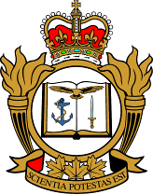
Kinetic Air Power in Robust Peacekeeping: the UN Operation in the Congo 1960-64
Dr. Walter Dorn
Canadian Forces College
& Royal Military College of Canada
13 June 2011
Notes:
All photos from UN unless otherwise stated
Libya: “UN first No Fly Zone”; NATO in Libya
Kinetic Air Power
Title originally proposed: “Air Attacks in Robust Peacekeeping: the UN Operation in the Congo 1960-64”
A. Walter Dorn and R. Pauk
Draft of 10 April 2011
The United Nations Operation in the Congo (abbreviated ONUC for the French name: Opération des Nations Unies au Congo) was the largest, most complex, and expensive UN mission until the end of the Cold War. It also was the most robust, utilizing air power in an unprecedented and almost unrepeated fashion in UN peace operations. An enormous expansion of ONUC’s air power occurred less than a year after the mission’s inception in 1960 when the operational mandate increased dramatically. The UN mission was first subject to air attacks and then became a protagonist in a shooting war using a UN "air force" of its own. Aerial surveillance played a crucial role, and the UN also initiated air attacks against an opponent who possessed lethal aerial assets. What was the UN experience with air power in this early mission and what lessons can be learned from it? The dangerous and forceful mission is worthy of a thorough review and exploration, drawing from newly-uncovered archival sources, especially as the United Nations considers the resort to air attacks in its current operations in the Congo and Ivory Coast.

Slide 2
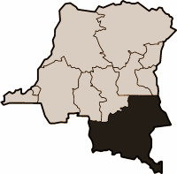
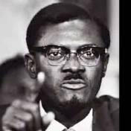
Congo 1960
Independence from Belgium (June 30)
Size of Western Europe
Larger decolonization process
Mutiny (July 5)
Belgian (re)deployment
Secession of Katanga (July 11)
Superpower proxy battles
Lumumba and Tshombe
Leopoldville
Kamina
Katanga
Elizabethville

Slide 3
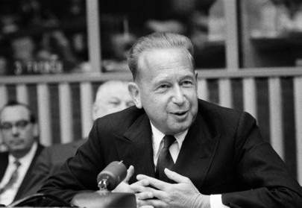
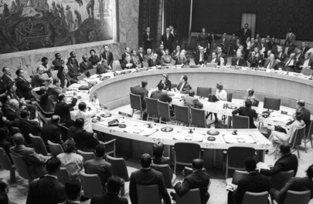
UN Intervenes (July 1960)
Secretary-General Dag Hammarskjöld leads (14 July)
Security Council Resolution 143 (17 July)
Unstated Goals:
- UN in, superpowers out
boost Central government up, push Katangan secession down
Notes:
SC Resolutions on the Congo
145 (22 July 1960)
Belgium to implement speedy withdrawal
Other states to “refrain from any action that might undermine the territorial integrity and the political independence of the Congo”
146 (9 August 1960)
Belgium to remove troops from Katanga
ONUC given authority to enter the province
161 (21 February 1961)
SC urges the ONUC to take all appropriate measures (chap VII?) to prevent the occurrence of civil war in the Congo
This resolution authorizes the use of force, if necessary, as the last resort
169 (24 November 1961)
Declares “full and firm support of the Central Government of the Congo”
all secessionist activities against RoC are contrary to SC decisions
ONUC expanded
UN expels Belgian and foreign personnel not under UN umbrella (military and political advisors)
“all necessary measures to prevent the entry” of such elements
199 (30 Dec 1964)
authorized withdrawal of ONUC from the Congo
Goals
- UN in the Congo to keep the superpowers out of the Congo, boost Central government up and keep Katangan secession down
Photo: Security Council Unanimously Recommends Admission of Sierra Leone to Membership in UN
27 September 1961, United Nations, New York, Photo # 376828
“In an advisory opinion entitled Certain expenses of the United Nations (ICJ Reports, 1962, p. 151 ff.),the International Court of Justice voted 9 to 5 that ONUC was ‘not an enforcement action within the compass of Chapter VII of the (U.N.) Charter.’ The opinion stated that ‘it must lie within the power of the Security Council to police a situation even though it does not resort to enforcement action against a State.’ One of the five dissenting jurists noted in his opinion that U.N. planes bombed positions, used antiaircraft batteries, engaged its forces in offensive maneuvers, and used deadly force in doing so. He noted that this would qualify as a common-sense case of enforcement. Page 6GAO/NSIAD-97-34 United Nations
http://www.tpub.com/content/cg1997/ns97034/ns970340008.htm

Slide 4
Opération des Nations unies au Congo (ONUC)
Largest and most complex UN op. in Cold War
20,000 troops
234 fatalities
Forerunner of multidimensional ops
Help restore law & order (nation-building)
Secure withdrawal of Belgian forces
Prevent secession
Increasingly robust over time
Air power: transport, medical
Later: kinetic/combat

Slide 5
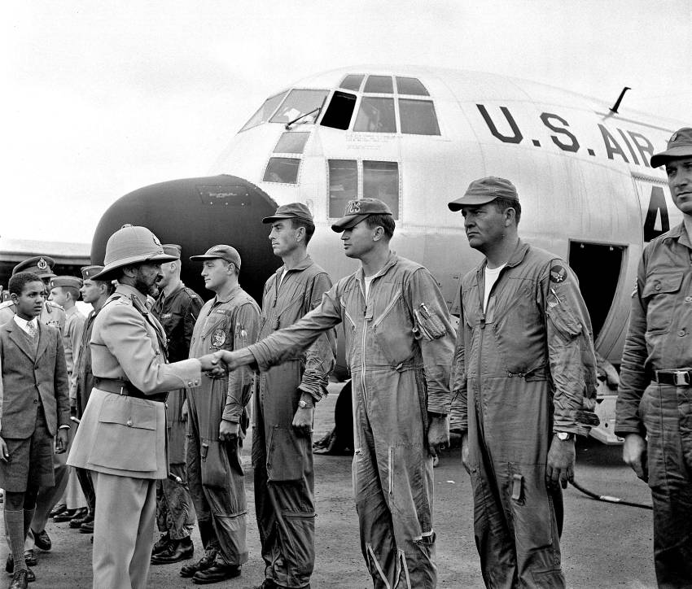
US Airlift
50 C-130; transported
9,000 UN troops in two weeks
UN Photo 183490/D.Zeit
Ethiopian Emperor Haile Selassie greets US airmen, 25 July 1960
Notes:
UN Force in the Congo - Following the Security Council resolution of 14 July 1960 authorizing UN military assistance to the Republic of the Congo, soldiers from a number of nations have been sent to help restore order and calm in the country. One of the countries to send contingents to help make up the new UN Force was Ethiopia. Before the departure of Ethiopian troops for the Congo, Emperor Haile Selassie I is greeting United States air force pilots. The U.S. is one of the countries helping to airlift troops to the Congo.
25 July 1960
Debre Zeit, Ethiopia
Photo # 183490

Slide 6
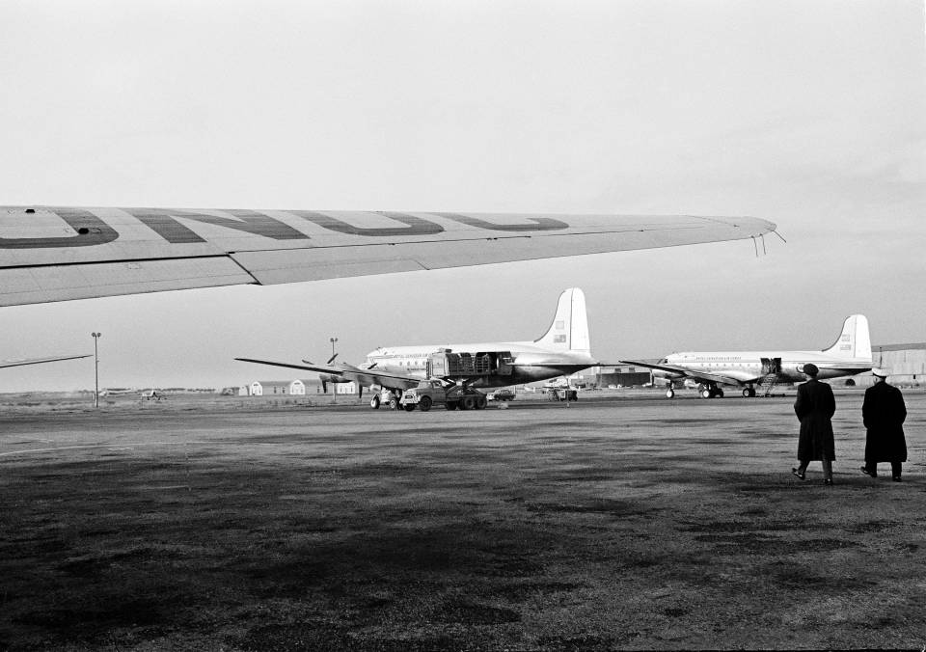
Staging Area: Pisa, Italy
UN Photo 72369
4 January 1962
Canadian "North Star" aircraft in ONUC service
Notes:
At ONUC and UNEF Staging Area in Pisa (Italy)
"North Star" aircrafts of the Royal Canadian Air Force which are now in service for ONUC are seen here on a runway at the local staging area maintained by the UN to handle the constant flow of cargo and traffic, as well as personnel, connected with the operations of ONUC and UNEF.
04 January 1962
Pisa, Italy
Photo # 72369

Slide 7
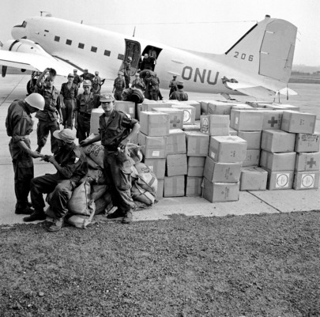
Air Supply
Food packages unloaded, Luluabourg airport, 10 August 1960
Notes:
United Nations Assistance in the Congo
Some 11,500 soldiers from nine countries are now on duty with the UN Force in the Republic of the Congo, helping to restore order and calm in the country. Assistance also includes technical and medical personnel, air transport, food, heavy materials and various supplies. Food packages are seen here after being unloaded at the airport.
10 August 1960
Luluabourg
Photo # 71330

Slide 8
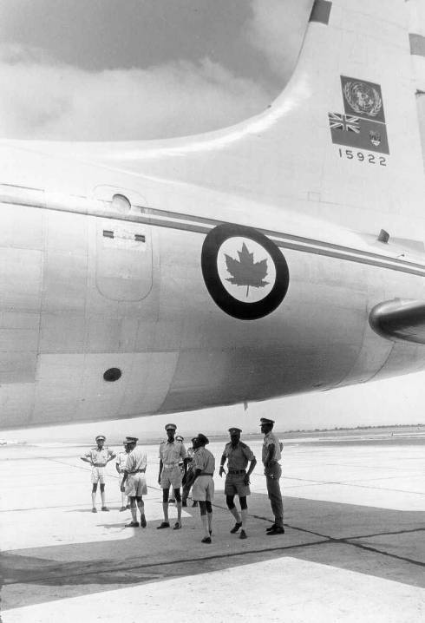
Canadian Yukon Aircraft, Leopoldville, 23 July 1962, with Congolese National Army Officers Replaced Canada’s North Stars on cargo/troop runs from Pisa
UN Photo 76016

Slide 9
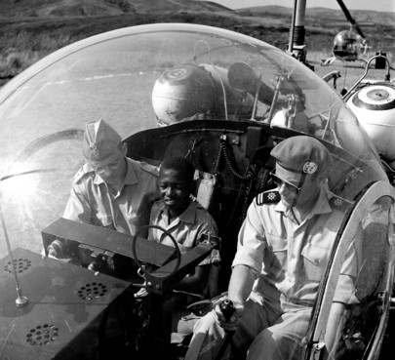
Humanitarian/Medical Evacuation
UN Photo 189903
Notes:
Medical Help for the Congo
Some thirty-three medical teams from 22 countries, with a total of 157 doctors, nurses and technicians, are at work in the Congo under the United Nations civilian operation. Among the teams are three from Denmark. Two members of a Danish team are seen arriving with a patient (centre) brought from a nearby village for medical care at the Matadi hospital. The youngster was flown in by helicopter. October 1960.
01 October 1960, Matadi, Congo (Photo # 189903)

Slide 10
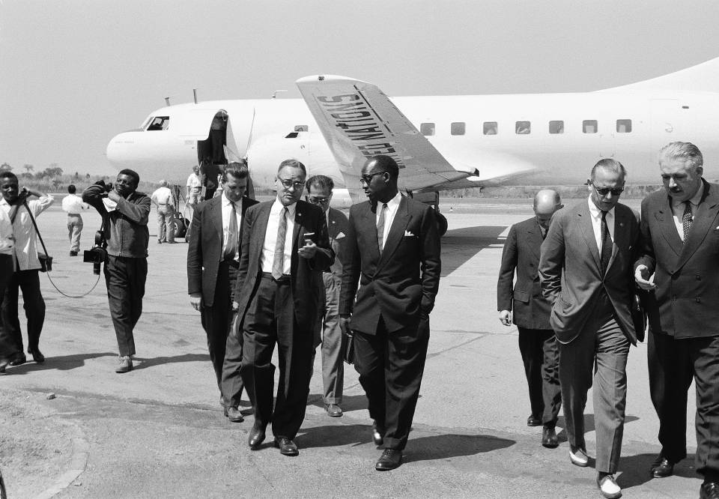
Transport of Diplomats & UN Negotiators
USG Ralph Bunche with Katangan Interior Minister, 5 August 1960
Notes:
United Nations Force in the Congo
Following the Security Council resolution of 14 July 1960 authorizing UN military assistance to the Republic of the Congo, some 11,500 soldiers from nine countries are now on duty helping to restore order and calm in the country. The Secretary-General sent his Personal Representative in the Congo, Ralph J. Bunche, to Elisabethville today for talks prior to the arrival of UN troops in the Katanga Province. The UN plane with technicians aboard was refused permission to land except for refueling. Ralph J. Bunche is seen here (front row, left) at the airport talking with Mr. [Godefroid] Monongo, Minister of the Interior of Katanga Province, prior to returning to Leopoldville, with the technicians.
05 August 1960
Elisabethville, Republic of the Congo
Photo # 71157

Slide 11
Katangan threat
Backed by Belgian Union Minière
Congolese government demands force
Soviet military aid (Illysishin-14)
Lumumba assassinated 17 January 1961
Res. 161: “all appropriate measures” to prevent civil war, “force, if necessary, in the last resort”

Slide 12
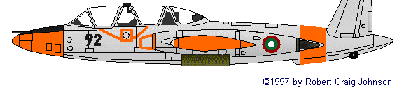
Katangan aircraft (1961)
Fouga Magister
Originally three
First one captured at Elizabethville airfield
Second lost due to pilot error
Third (“lone ranger”): piloted by mercenary Joseph Deulin
Attacked UN convoys, troops, transport aircraft & airfields (Elisabethville and Kamina), UN headquarters in Katanga
Caused havoc

Slide 13
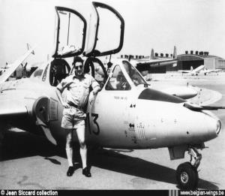
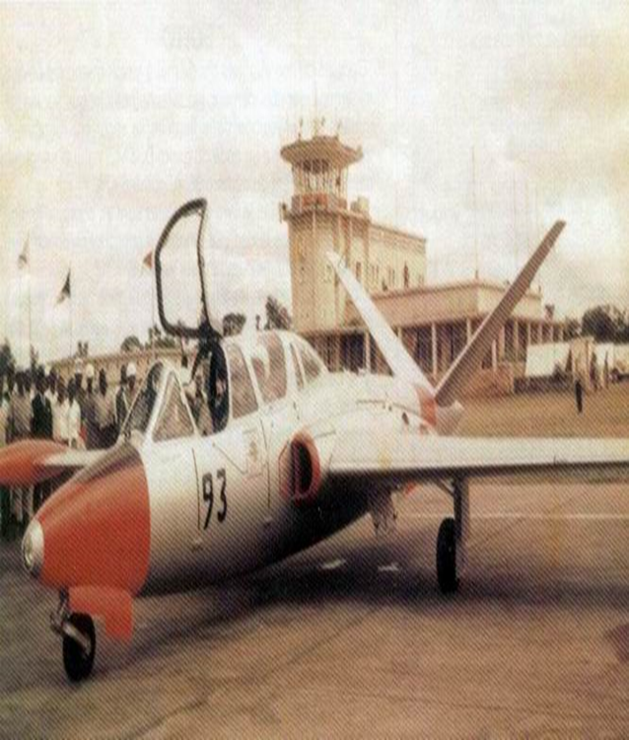
“I have always believed in air power, but I never thought I’d see the day when one plane would stop the United States and the whole United Nations.” – Wayne Fredericks, US State Department

Slide 14
UN Early Offensives
Operations Rum Punch (Aug 1961)
Limited “success”
Operation Morthor (“Smash”) (Sept 1961)
Viewed as “failure”
Objection from Hammarskjöld
No kinetic air
Havoc from Fouga Magister
Notes:
Rum Punch – August 1961 - Controversial Objectives: Temporary detention of Munungo, Seizure of radio station & post office, - Successful but reprimand from Hammarskjold
Morthor – 13-21 September 1961 – bombed and strafed by Fouga jet - Arrest of Munungo; Seizure of radio station & post office - Failed

Slide 15
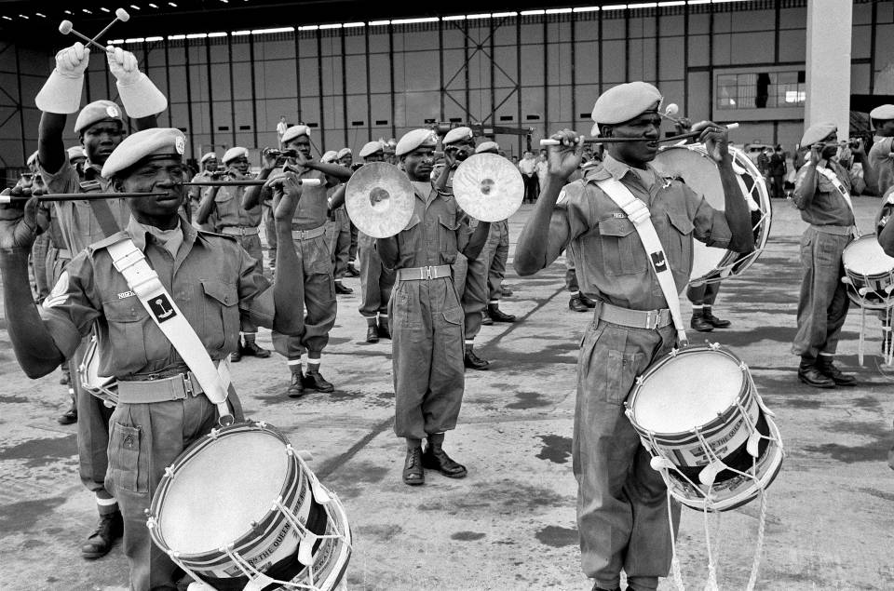
26 September 1962
UN Photo 184408
Swedish airmen funeral, Leopoldville (Kinshasa)
Twin-engine transport shot down on 20 September
Notes:
Funeral Held in Leopoldville for Swedish Airmen
A ceremonial military funeral was held in Leopoldville today for Warrant Officers Per Olov Gunnar Solvestad and Raoul C. Gosta Colmgren, two members of the ONUC Swedish contingent who died when a UN twin-engine transport plane was shot down on 20 September near Kamuza, in the Kabongo area. Seen here is the Nigerian Army Band which played the "Last Post".
26 September 1962
Leopoldville, Republic of the Congo
Photo # 184408

Slide 16
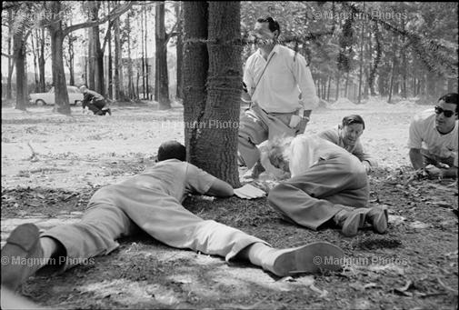
UN leaders strafed during press conference by Katangan jet
Representative of SG in Katanga, Conor Cruise O'Brien (on ground facing camera in jacket)
September 1961
Ian Berry, http://www.magnumphotos.com/image/LON124375.html
Notes:
“Conor Cruise O'Brien (facing camera in jacket), being strafed during a press conference by Katanga's only aeroplane. 1961.”

Slide 17
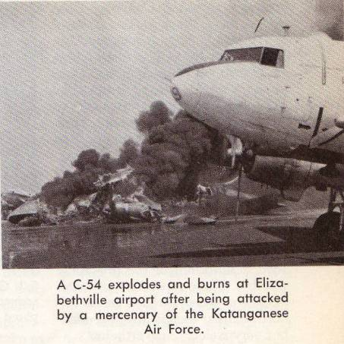
Roundel: Canadian Air Force News, Jan-Feb 1964, p.13

Slide 18
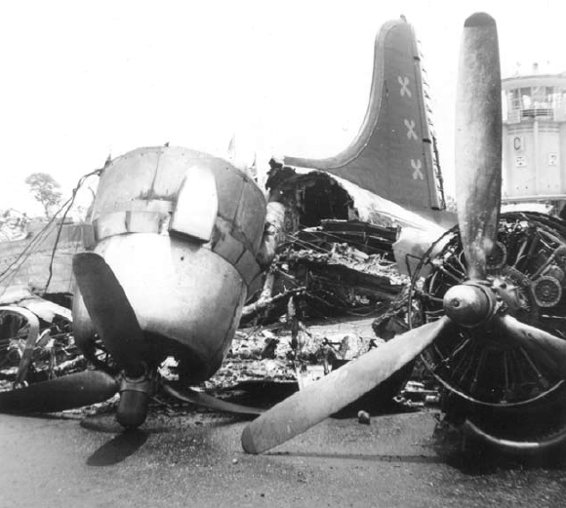
Attacked by a Fouga Magister at Elizabeth airport
Photo from Michael Whelan, The Battle of Jadotville: Irish Soldiers in Combat in the Congo 1961, South Dublin Libraries, 2006 (courtesy of John Gorman).

Slide 19
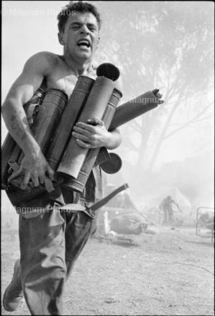
Irish UN soldier flees from the exploding ammunition dump, Elizabethville: 1961
http://www.magnumphotos.com/image/LON71515.html
Notes:
“Ian Berry AFRICA. Congo. Katanga. Elizabethville. An Irish UN soldier flees from the exploding ammunition after the dump blew up. 1961.Image Reference. LON71515 (BEI1961010W00046/23)” http://www.magnumphotos.com/image/LON71515.html

Slide 20
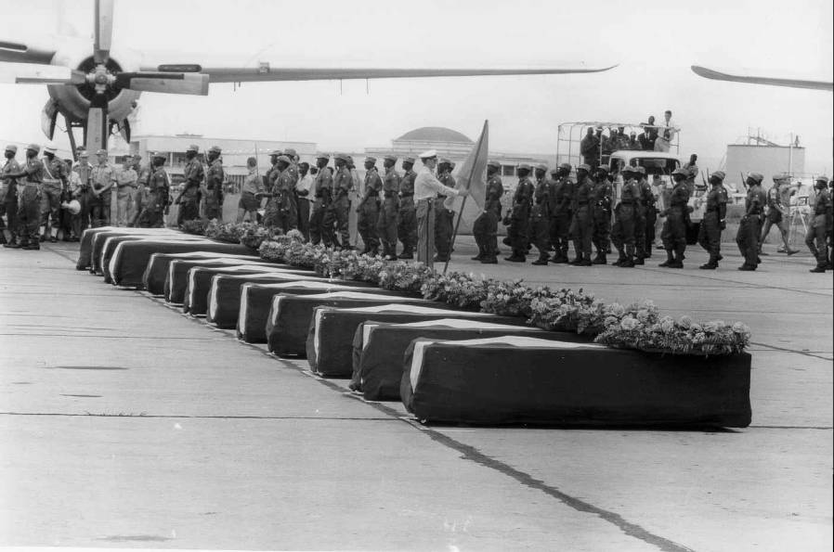
UN Peacekeeper’s Coffins
UN Photo 74151
13 Italian airmen seized and murdered in Kivu by ANC-Stanleyville forces

Slide 21
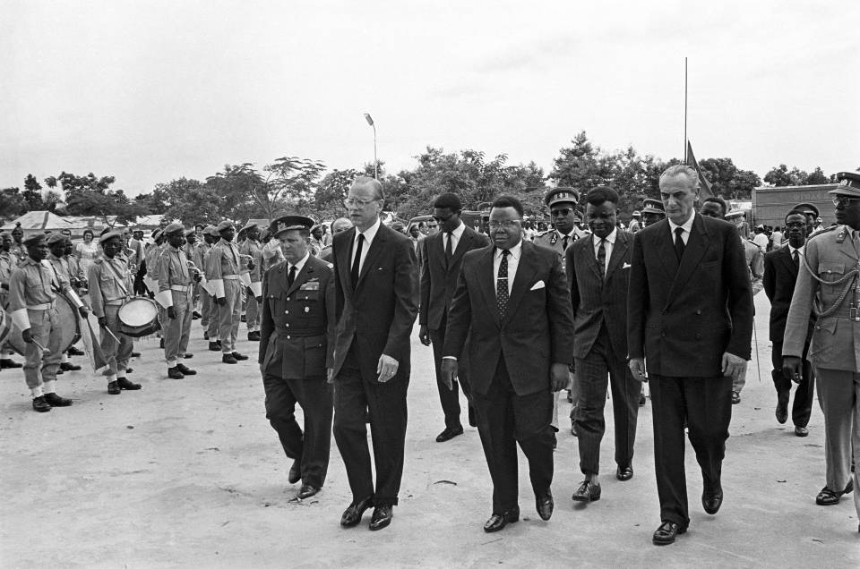
18 November 1961
13 Italian Airmen – Memorial Service Centre: SRSG Sture Linner & President Joseph Kasavubu, flanked by Italian officials.
UN Photo
Notes:
Memorial Service for Italian Airmen Murdered in Congo
Representatives of the United Nations, Italy and the Congo enter Leopoldville's Church of Notre Dame du Congo where a memorial service was held today for the 13 Italian airmen murdered in the Congo province of Kivu a week ago. In the foreground are (left to right) General Alessandro Cerruti, of the Italian Air Force; Dr. Sture Linner, Special Representative of the Secretary-General in the Congo; Congolese President, Joseph Kasavubu; and Italian Ambassador Pietro Franco.
18 November 1961
Leopoldville, Republic of the Congo
Photo # 213989

Slide 22
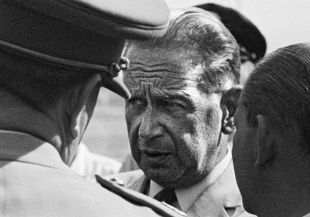
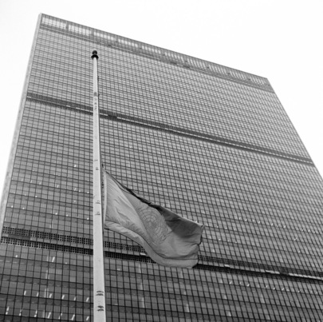
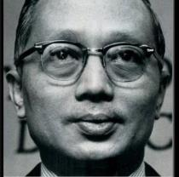
Dag Hammarskjöld in plane crash
Plane route
Detour
In range only after dark
Strict radio silence
17 September 1961
U Thant (Burma) elected
30 November 1961
Notes:
UN Secretary-General Dies
The flag of the United Nations is seen flying at half-mast following the confirmation of the death of UN Secretary-General Dag Hammarskjöld in an air crash in Africa.
18 September 1961
United Nations, New York
Photo # 99389

Slide 23
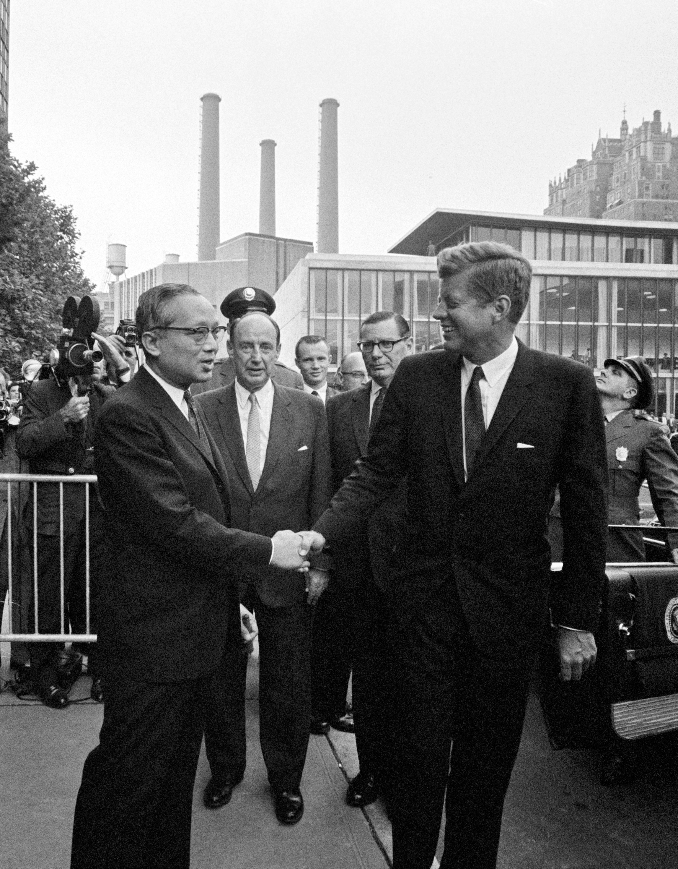
Creation of a “UN Air Force”
Hammarskjöld’s leadership
Armed aircraft: Ethiopia, India, Sweden
Pres. Kennedy offers eight US jets
Joint Chiefs: “seek out
and destroy on ground
or in the air the Fouga Magister jets”
Thant declined
(to avoid superpower conflict)

Slide 24
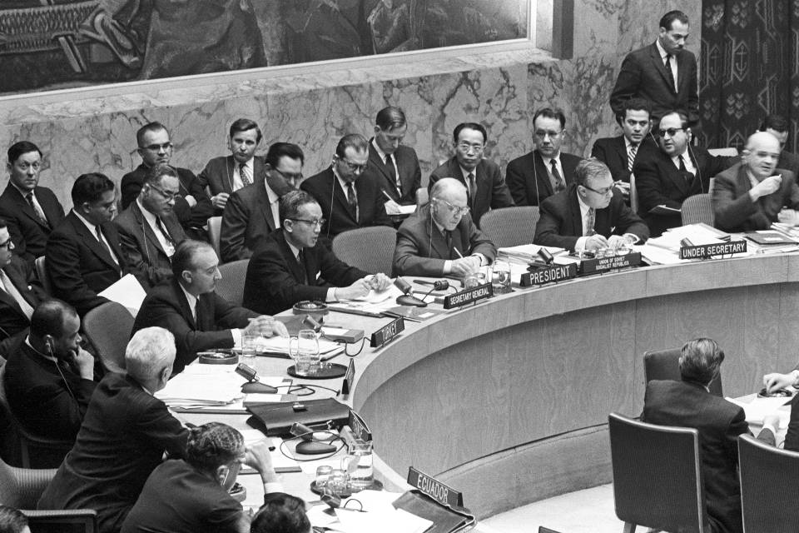
24 November 1961
UN Photo 214006
Council debates before passing resolution 169: force authorized to expel mercenaries
Notes:
Security Council Continues Debate on Situation in the Congo
The Security Council met today to continue the debate on the situation in the Republic of the Congo. U Thant (fourth from right), Acting Secretary-General of the UN, addresses the meeting. To his left is Mr. Valerian A. Zorin (USSR), President of the Security Council.
24 November 1961
United Nations, New York
Photo # 214006

Slide 25
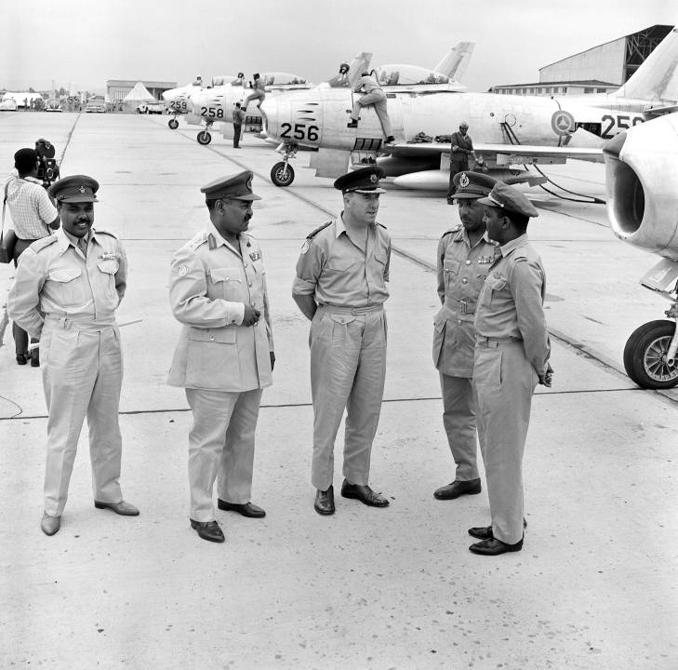
Ethiopian Sabre Jets
Leopoldville, 3 October 1961
Notes:
Ethiopian Sabre Jets Arrive in Congo for UN Duty
Four Sabre jets of the Imperial Ethiopian Air Force Detachment in the Congo arrived at Leopoldville today for UN duty in the Congo. Commander of the UN Force, Lt. Gen. Sean McKeown (centre of group) chats with fellow-officers after a formal inspection of the Sabres (background) and their crews at Ndjili airport. From left to right are: Major Tarrekegn G.M., Ethiopian Liaison Officer with UNOC; Major-General Mangasha Iyassu, Senior Military Advisor to the Congolese Central Government and former deputy UN Force Commander; Lt. Gen. McKeown; Major-General Gabre-Leul Yacob, recently-appointed deputy UN Force Commander; and Major Assefa, Ethiopian Squadron Commander.
03 October 1961
Leopoldville
Photo # 167826

Slide 26
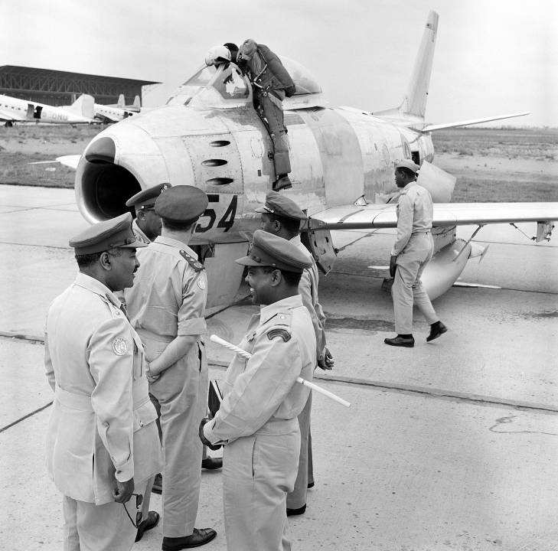
Notes:
Ethiopian Sabre Jets Arrive in Congo for UN Duty
Four Sabre jets of the Imperial Ethiopian Air Force Detachment in the Congo arrived at Leopoldville today for UN duty in the Congo. A pilot climbs into the cockpit in readiness for an air display by the Sabres, following a formal inspection at Ndjili airport by the Commander of the UN Force in the Congo, Lt. Gen. Sean McKeown (seen here in the centre of the group, watching the pilot). Other officers with him are: (in foreground) Major-General Iyassu Mangasha, Senior Military Advisor to the Congolese Central Government and former deputy UN Force Commander (left) and Major Tarrekegn G.M., Ethiopian Liaison Officer with UNOC (right); and (in background) Major-General Yacob Gabre-Leul, recently-appointed deputy UN Force Commander (left) and Major Assefa, Ethiopian Squadron Commander (right).
03 October 1961
Leopoldville
Photo # 167827

Slide 27
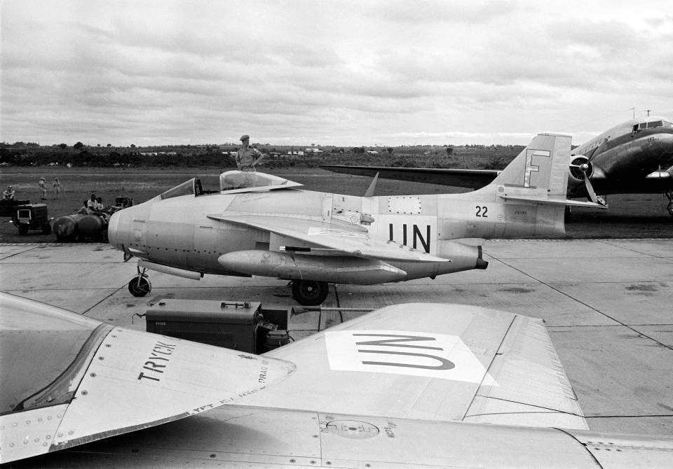
Swedish Saab J29 Jets
27 October 1961
“Flying Barrels “
UN photo 72365
Notes:
United Nations Force in the Congo
A partial view of the Luluabourg airport, showing some of the Swedish Saab J-29 jet planes which have just been placed at the disposition of the UN Force in the Congo (ONUC). Called "flying barrels", the jets are manned by members of the Swedish Air Force, numbering some 40 pilots and maintenance officers.
27 October 1961
Luluabourg
Photo # 72365

Slide 28
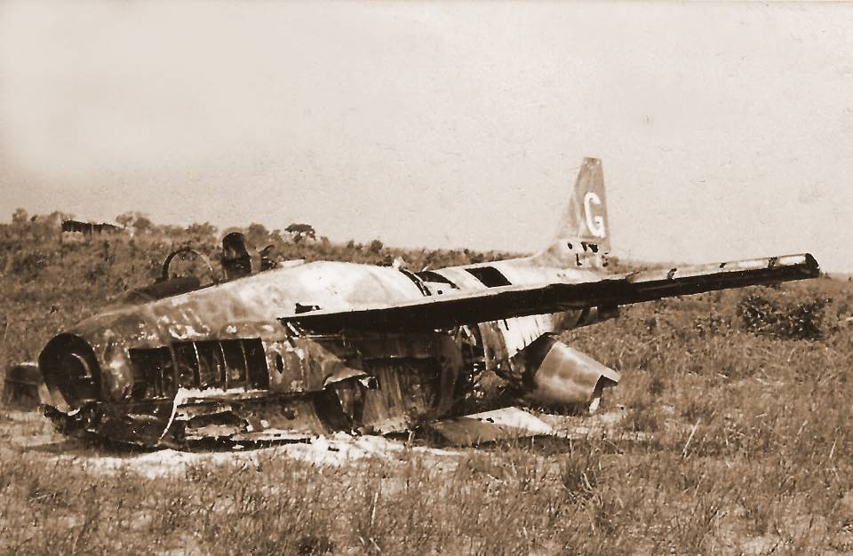
Wreckage of Saab 29 fighter in the Congo
Svenn Willy Mikaelsen
http://larsgyllenhaal.blogspot.com/2010/10/nordic-soldiers-in-congo.html
Notes:
Not only the Swedish Army contributed to the UN forces in Congo. This wreck of a Saab 29 fighter aircraft, in Sweden often called Flygande tunnan ("The Flying Barrel"), was photographed in Congo by Svenn Willy Mikaelsen from Narvik, Norway. PHOTO:

Slide 29
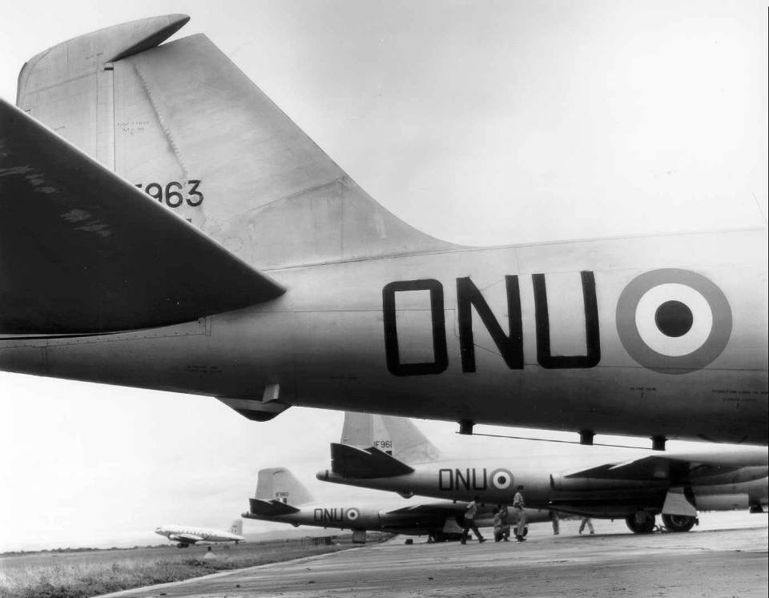
Indian Canberra Bombers

Slide 30
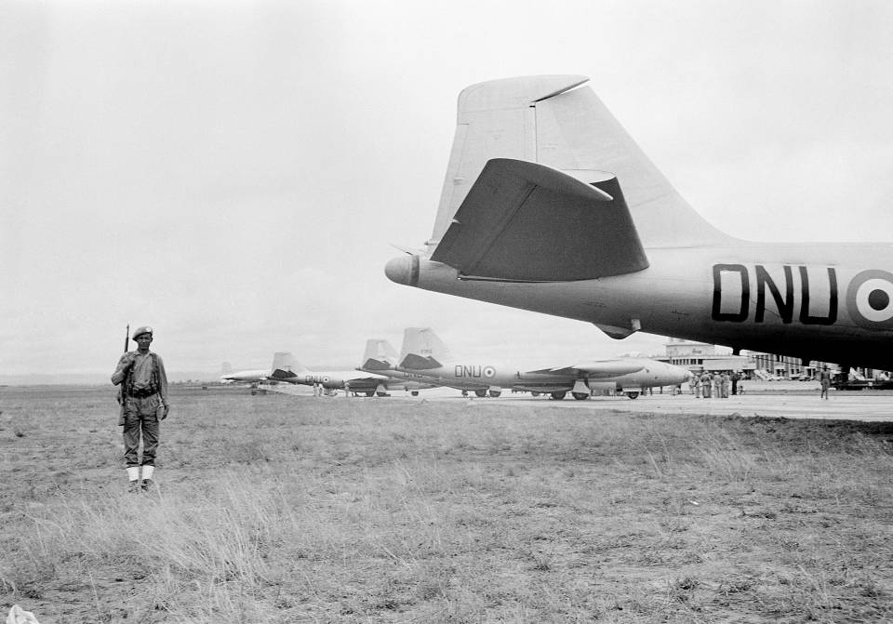
10 October 1961
UN Photo 71337
Indian Canberra Bombers
Notes:
Indian Air Force Sends Bombers for UN Duty in the Congo
Four Canberra bombers from the Indian Air Force arrived at Leopoldville today for United Nations duty in the Congo at the request of the UN. They were greeted at N'Djili airport by the Indian UN contingent commander in the Congo, Brigadier Sartaj Singh. The ONU markings (United Nations Organization), as seen on one of the jets here, were painted on before leaving India.
10 October 1961
Leopoldville
UN Photo # 71337

Slide 31
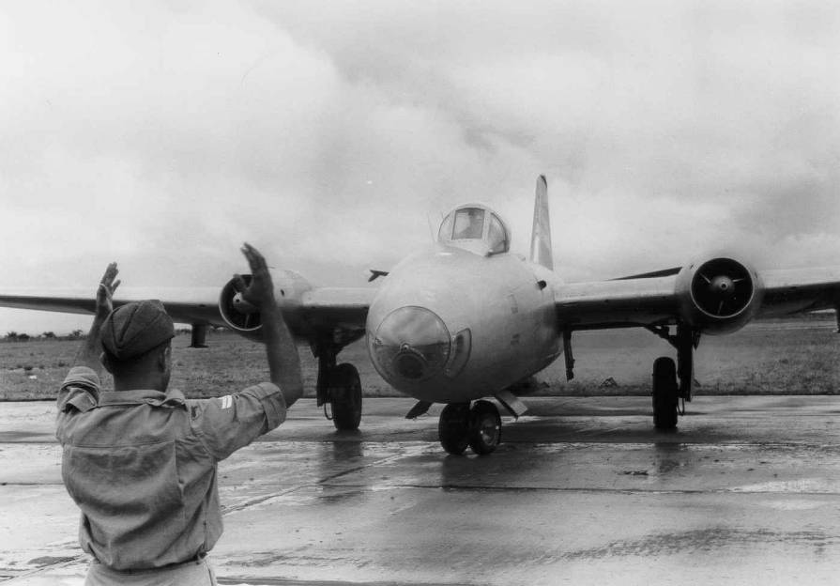

Slide 32
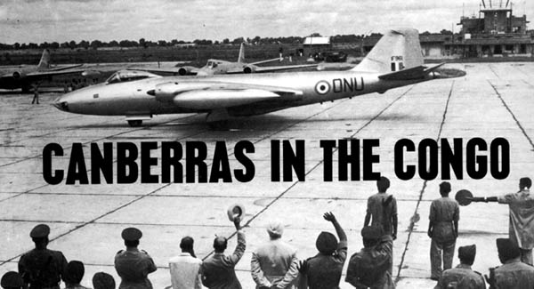
Source:
http://www.bharat-rakshak.com/IAF/History/Congo.html
(5 photos)

Slide 33
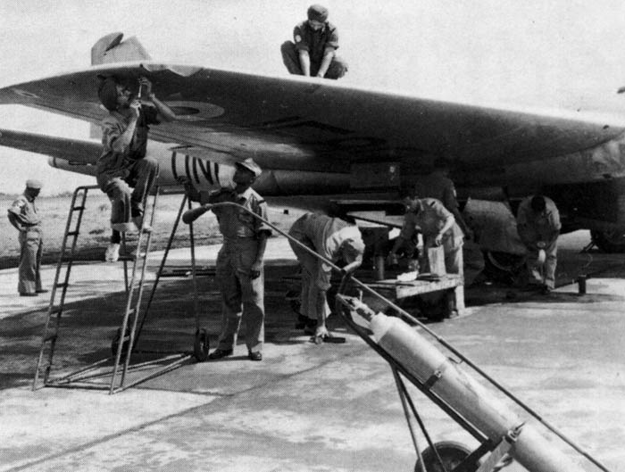

Slide 34
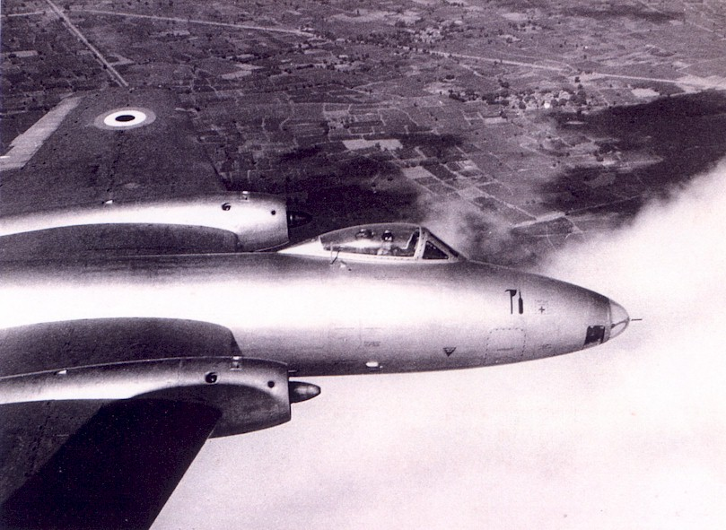
Sqn Ldr PM Wilson in the cockpit of a Canberra

Slide 35
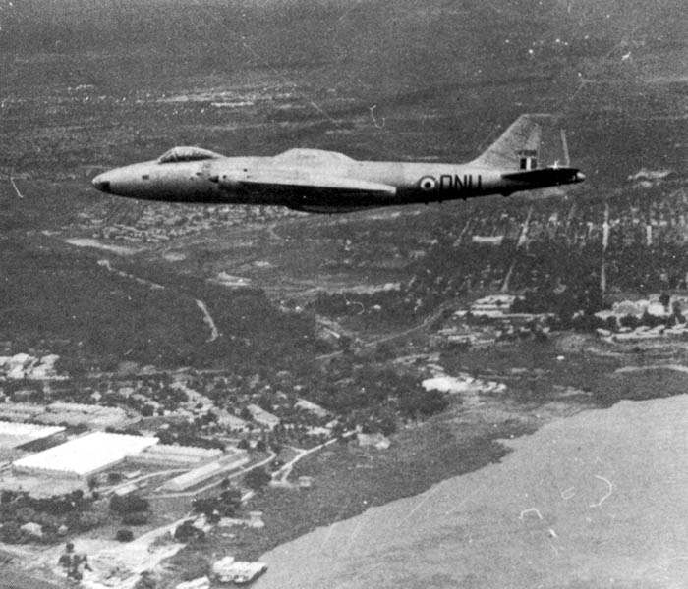

Slide 36
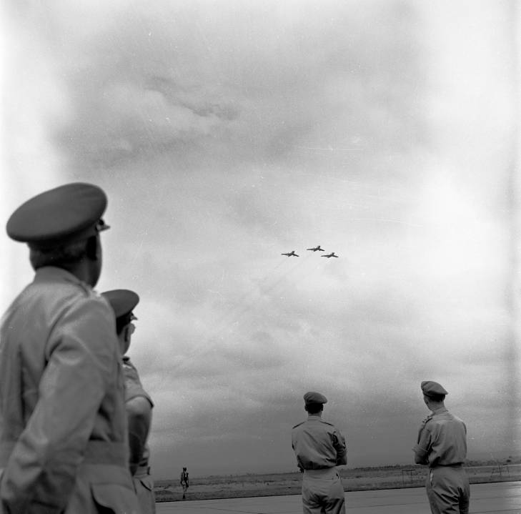
Notes:
UN Photo 72372

Slide 37
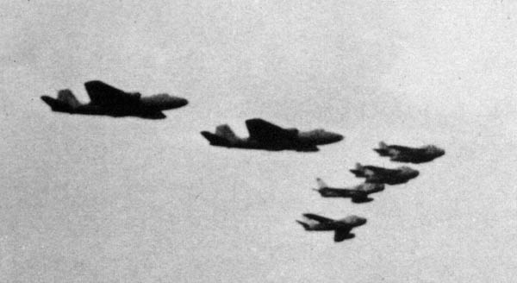
http://www.bharat-rakshak.com/IAF/History/1960s/Congo01.html
Flying in Formation:
2 IAF B(1) Canberras; 2 Swedish J29s Saabs; 2 Ethiopian F-86 Sabres
Notes:
“a photograph that epitomises the nature of the United Nations effort in the Congo”
www.bharat-rakshak.com/IAF/History/1960s/Congo01.html

Slide 38
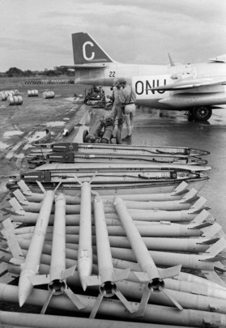
Rockets for SAAB jets,
Elisabethville airport
UN Photo 72379
Notes:
UN Photo 72379
Elisabethville airport are rockets for the United Nations Force in the Congo (ONUC) Saab jets.
03 January 1963

Slide 39
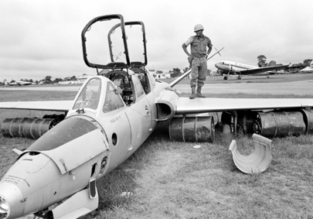
UN Photo 184390
Captured "Fouga" fighter in December 1961, Elizabethville airport
Notes:
The United Nations Force in the Congo, December 1961
A soldier of the U.N. force examines a "Fouga" fighter plane of the Katanga Air Force which was destroyed during the fighting which recently took place in the area.
01 January 0001
Elizabethville, Congo
Photo # 184390

Slide 40
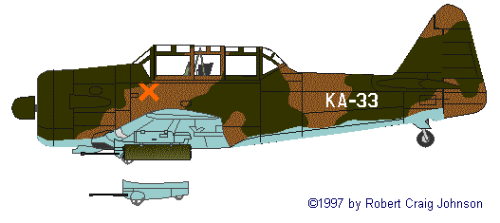
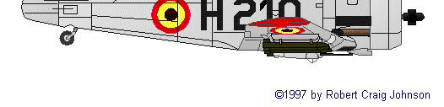
Katangan Air Force Expansion (1962)
Ex-Belgian T-6G
Harvard IV Fire Assistance Flight
Kamina-based

Slide 41
1962
Aerial “arms race” with Katanga
ONUC’s Military Information Branch (MIB) gathers intelligence
South African company offer 40 Harvards
Both sides also increase transport aircraft
UN acquires S-29E photo-recce aircraft
Camouflage colours applied to S-29 after FAK attacks on airfields
Britain dithers on providing bombs for Canberras
Limited operations until December

Slide 42
“We are not attempting to destroy any aircraft found in the airfield in the vicinity of that area [Kolwesi airfield] because if we do locate one or two aircraft and destroy them, we feel that FAK will react against Kamina Base and also disperse their aircraft from Kolwezi to other airfields, thereby making our task of locating and destroying these aircraft on the ground very difficult.”
Force Commander General Kebbede Guebre to Dr. Ralph Bunche, 24 November 1962

Slide 43
ONUC Strategy
Overwhelming surprise attack
Avoid FAK hiding aircraft
Avoid retaliation in kind
Obtain Norwegian anti-aircraft battery
200 strong
Air surveillance radars
Installed Aug 1962 in Elizabethville
Pres. Kennedy offers fighter jets without US pilots
Thant defers
Notes:
On Pres. Kennedy’s offer see http://history.state.gov/historicaldocuments/frus1961-63v20/d120
120. National Security Action Memorandum No. 9711.
Washington, September 19, 1961.
TO: The Secretary of State
SUBJECT: Use of U.S. Fighter Aircraft in the Congo
The President at 4 p.m. on September 19 authorized the dispatch of U.S. fighter aircraft with the necessary logistical support to the Congo, on a contingency basis. This authorization would become effective only if no fighter aircraft of other nations were made available to the United Nations,22. Telegram 823 from USUN, September 19, reported that Bunche had stated that India was going to make jet aircraft available and that the United Nations had decided to request U.S. jet fighters only if it was unable to obtain them from India or Ethiopia. (Ibid., Central Files, 770G.00/9–1961) and the President specifically directed that the mission of U.S. fighter aircraft would be to support and defend U.S. and U.N. transports or other U.N. forces that might come under air attack. There will be no effort to seek out and destroy Fouga Magister jets not attacking U.S. or U.N. forces without further authority from the President.
In the President's view it is of high importance that U.S. fighter aircraft be understood to intervene only in defense of beleaguered U.N. forces. He is not prepared to authorize their use at this time in offensive activities against Katangan forces.
McGeorge Bundy

Slide 44
Operation Grand Slam: The Trigger
Katangans shoot down UN observation helicopter
1 Indian crew member died of bullet wounds
Continuous firing on UN positions
UN escorts Tshombe to site of fighting to show his forces responsible
Katangese Gendarmerie Commander ordered bombing of Elizabethville airfield 29 December (radio interception)
Gen. Prem Chand convinces Thant for offensive

Slide 45
“Grand Slam” (28 Dec 1962)
All “bases loaded”
0430 hrs J-29s attacked Kolwezi airfield
20 mm canons
cloud cover too low for 13.5 mm rockets
3 UN aircraft hit by ground fire: narrowly missing pilot
Continued for 4-7 days
76 sorties
Target aircraft, petrol dumps
J29 patrol skies to prevent introduction of new aircraft
Thant does not approve use of napalm

Slide 46
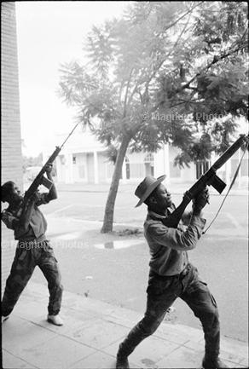
Katangan soldiers shooting into the sky, Elizabethville, 1961
http://www.magnumphotos.com/image/LON124394.html

Slide 47
Charanjit Singh’s Canberra IF 898 after local repairs to windscreen day after hit by ground fire; back to flying next day

Slide 48
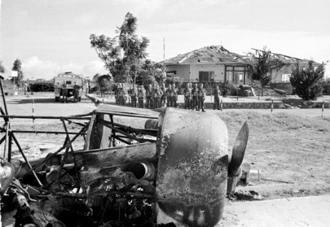
UN Photo 167830
Katangan Harvard destroyed on ground by Swedish jets on 30 December 1962
Notes:
UN Photo 167830
Activities in the Province of Katanga
Several months after the end of the hostilities between ONUC (UN Operation in the Congo) troops and Katangese soldiers, the remnants of a destroyed Harvard plane is one of the few leftovers, which remind us of the fighting. This and other planes which belonged to the Katangese air force here at Kolwezi, were destroyed on the ground by Swedish jetfighters on 30 December 1962. The Swedish SAAB-built planes formed part of the United Nations Air Force and they were flown by Swedish crews.
01 March 1963
Katanga
Photo # 167830

Slide 49
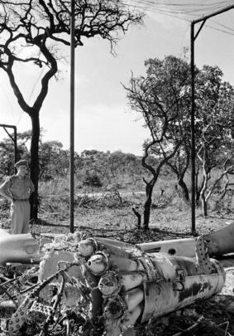
Vampire aircraft destroyed by Swedish fighter jets,
Kolwesi airport
UN Photo 167829
Notes:
Photo # 167829
At Kolwesi airport a destroyed Vampare [sic] aircraft reminds of the fighting some months ago, between ONUC (UN Operation in the Congo) troops and Katangese troops. This plane was destroyed on the ground by Swedish Fighter Planes which formed part of the United Nations Air Force during the hostilities.
01 March 1963
Katanga
Source: http://www.unmultimedia.org/photo/detail.jsp?auto=1&id=167/167829&key=6&query=organization:ONUC%20AND%20category:"Field%20coverage"

Slide 50
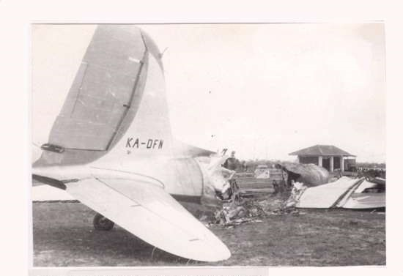
KA DFN destroyed by UN jets, Kolwezi, 6 December 1961
http://vayu-sena-aux.tripod.com/pix/ONUC_destroyed_DC-3_Congo_03B_01.jpg
Notes:
“KA DFN was destroyed by UN jets at Kolwezi December the sixth 1961”

Slide 51
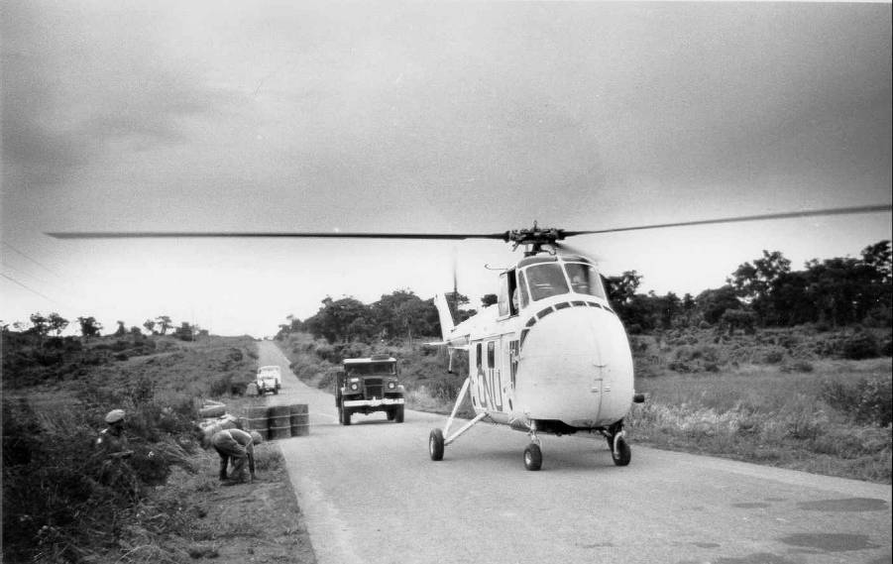
Securing road blocks & positions around Elisabethville, 3 January 1963

Slide 52
January 1963
Tshombe agrees to end his secession & give up military means
Meets UN demand/ultimatum
No UN personnel killed in Op Grand Slam
215 killed in ONUC 1960-64

Slide 53
Delay would have been costly
ONUC intelligence (subsequently): 15 FAK aircraft (Mustangs) hidden in Angolan airfields
Belgian mercenary interrogated:
“If you had only given us four more weeks so that we could have got the Mustangs ready, you would have experienced the same disastrous surprise one early morning at your Kamina Base as we experienced at Kengere [Kolwesi] on 29 December.”
ONUC victory in the nick of time
Notes:
Timing is everything!

Slide 54
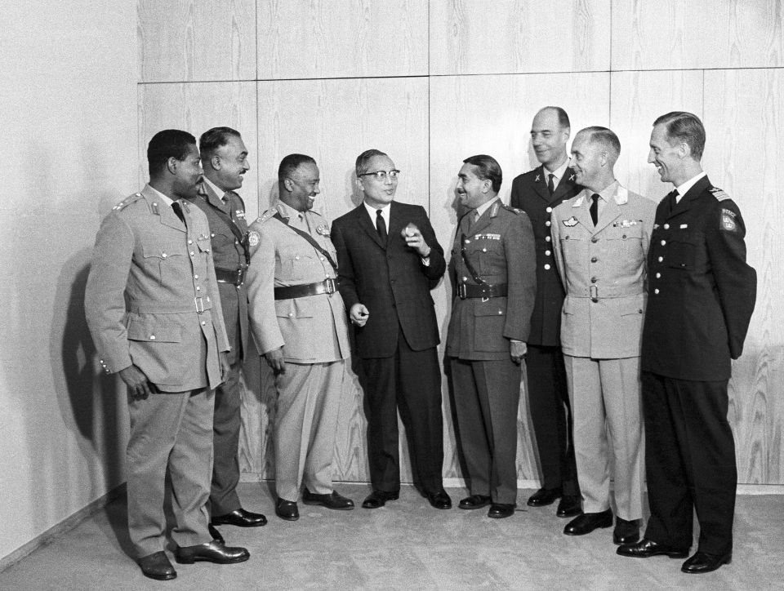
U Thant with officers from Nigeria, India, Ethiopia (Force Commander Lt. Gen. Kebede Guebre); Thant; India (Maj. Gen. D. Prem Chand, GOC Katanga Area); Sweden; Norway (Gen. C.R. Kaldager, Air Commander); and Commander of the Swedish Air Jet Fighter Unit
UN Photo 210787
8 April 1963

Slide 55
Conclusions
Dispels the myth of peacekeeping as non-combat
ONUC Air Force: air combat patrols, air-to-air combat, close air support, strikes against airfields, reconnaissance
Established and enforced de facto no-fly zone
US backing but no US fighter planes
Importance of precedents & being aware of them!
Defence/offense
Secured freedom of movement
Responded to attacks

Slide 56
Conclusions
Showed utility of air intelligence and air combat
Air Intelligence
Utility of aerial recce
Limits of aerial recce: Italian airmen case (13 November 1961)
Need for gathering intell on air capabilities, incl. in foreign countries
Air Combat
Establish ROEs and Force Directives (see paper)
Recognize the dangers of collateral damage
Accused of bombing a hospital and hotel
Mortar fire on a hospital

Slide 57
Collateral Damage
“During the fighting, ONUC troops limited their attacks strictly to military objectives and so did the ONUC aircraft which were sent into action only when absolutely necessary. Some civilian installations were unfortunately, hit accidently by misguided fire but they were very few. Strict orders were given to ONUC troops to safeguard to all extent possible the lives and properties of the civilian population.”
United Nations, “The United Nations and the Congo” (July I960 - February 1962), 1 March 1962
Source: Items-in-Peace-keeping operations - United Nations Operations in the Congo - Congo White Paper - The United Nations and the Congo, 01/03/1962

Slide 58
Conclusions II
Psychological effect of air power
Threat from the skies from “Lone Ranger” Fouga Magister
Morale booster for ground troops from UN “Air Force”
Show of force (fly past) to Katangans

Slide 59
ONUC
Mission challenged and exhausted UN
At hq long before DPKO created (1992)
Controversial among states and in media
Katanga lobby
UK, French fears
Soviet objections
Non-aligned movement
Expensive: almost sent UN into bankruptcy
Difficulties in field: C2, armaments (bombs), casualties, bad press
Messy situation
No mission in Africa until 1989 (Namibia)

Slide 60
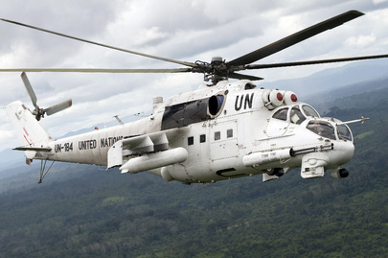
Back to the Congo …
UN Photo 200146
Indian MI-35 attack helicopters:
4 deployed to the Congo in 2004
Notes:
UN Helicopter on Aerial Patrol
An MI-24 helicopter of the United Nations Mission in Liberia (UNMIL) on aerial patrol in search of the illegal marijuana plantations.
17 September 2008, Monrovia, Liberia (Photo # 200146)

Slide 62
Extra Slides

Slide 63

Notes:
The UN “air force” in 1963, after Op Grand Slam, showing (at the bottome the IIAF Sabre aircraft (Imperial Iranian Air Force) that had arrived.

