Slide 1
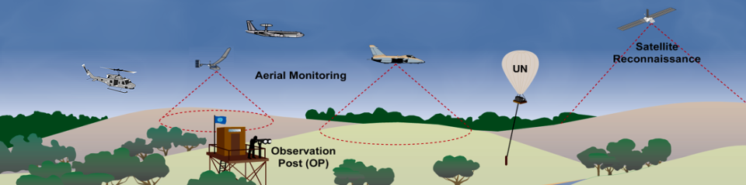
EYES IN THE SKY :
From Manned to Unmanned Aerial Reconnaissance in UN Peace Operations
Dr. Walter Dorn
Unmanned Aerial Systems (UAS) Summit, Ottawa, 15 December 2011

Slide 2
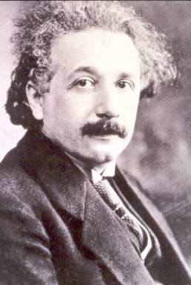
“Concern for man himself and his fate [humanity itself and its fate]
should be the chief interest of all technical endeavors.
Never forget this in the midst of your diagrams and equations.”
– Albert Einstein

Slide 3
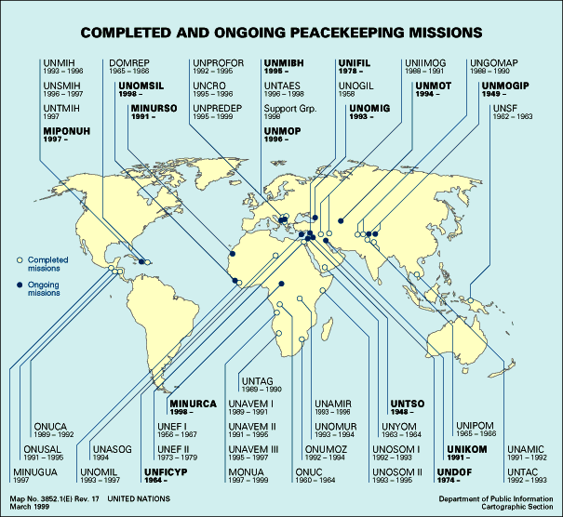
Peacekeeping (First 50 Years)

Slide 4
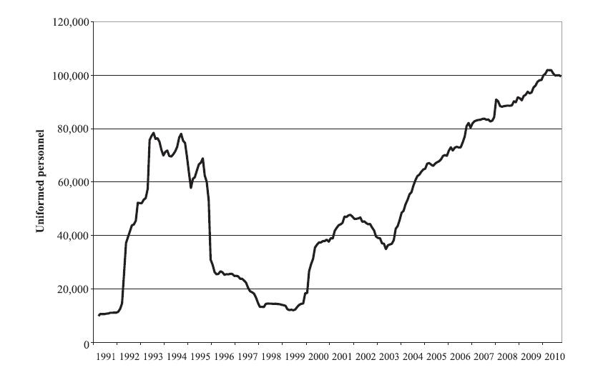
UN Peacekeepers (Military & Police,1991-)
©W.Dorn

Slide 5
UN Peacekeeping Today

Slide 6
Monitoring tasks
  Cease-fires
  Peace agreements
  Armed groups and spoilers
  Protected areas and persons
  Humanitarian conditions & relief
  Elections and human rights
  Sanctions and no fly-zones
  Resource exploitation
  Safety & security of UN personnel
  “A MONITORING GAP”
Notes:
Peace operations have many mandates in the field, which has greatly expanded in multidimensional PKOs.
But there is an enormous “monitoring gap” between the mandates and mission capabilities.

Slide 7
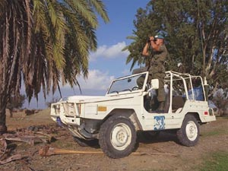
Traditional Tools
The human eye ... sometimes aided by binoculars
Ground-based
Notes:
In peacekeeping missions, the UN has relied almost exclusively on the human eye for observation.
Not sufficient ....

Slide 8
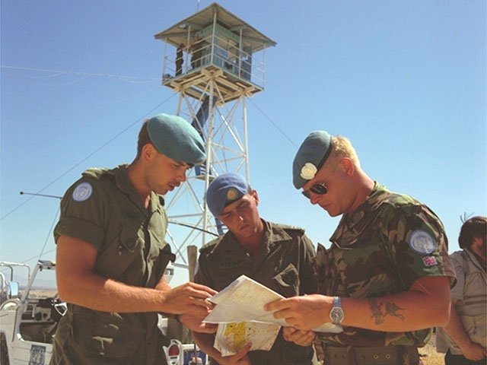
Observation Tower

Slide 9
Problems of Unaided Monitoring
Limited capabilities ...
  over large areas
  at night
  for underground detection
  in remote/difficult terrain
  information recording, analyzing, sharing and storage

Slide 10
Benefits of Monitoring Technologies
Increases range and accuracy of observation
Permits continuous monitoring
Increases effectiveness
  cost-effectiveness in some cases
Decreases intrusiveness
Enhances safety of staff in field
Provides recordings/evidence

Slide 11
Cooperative Monitoring Technologies
“Tools of the Trade?” (independent commissioned report)
Notes:
11

Slide 12
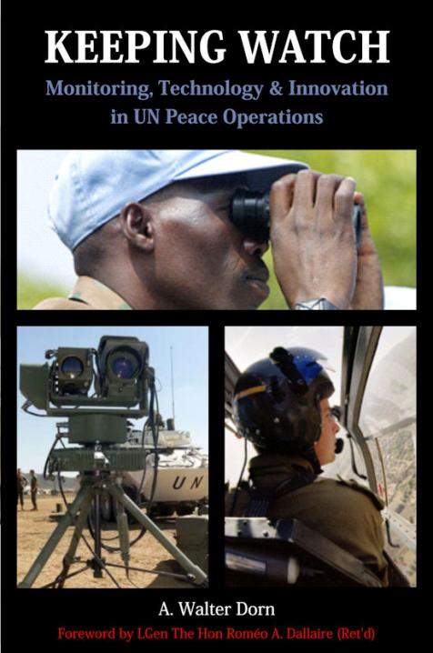

Slide 13
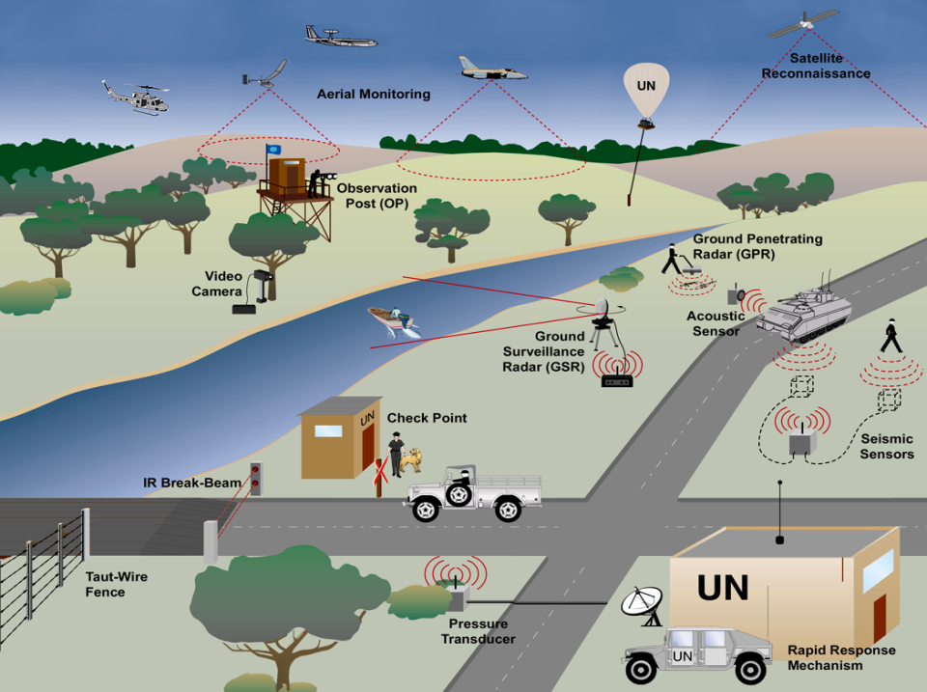
Source: W.Dorn
Notes:
In my paper I look at 9 categories of technology:
1. Satellite and Aerial Reconnaissance
2. Ground Imagery (Video) and Motion Sensors
3. Night Vision
4. Radars
5. Radio Monitoring (communications interception)
6. Acoustic and Seismic Sensors
7. Chemical/Biological/Nuclear sensors
8. “Blue Tracking”
9. Geographic Information Systems

Slide 14
Air vs Ground Observation
Bird’s eye view
  Longer, wider, less solid obstacles, adjustable altitude/visibility
  But clouds, fog, smoke or smog, turbulence
Faster, more direct
  Not as close, time on target depends
Host state control depends

Slide 15
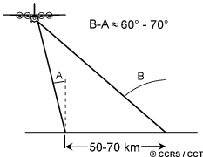
Oblique Viewing

Slide 16
Aerial Observation in
UN Missions
Sinai
Cyprus
D.R. Congo
Haiti

Slide 17
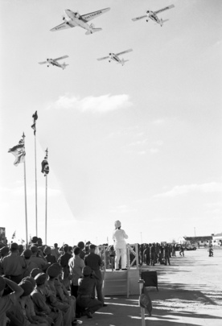
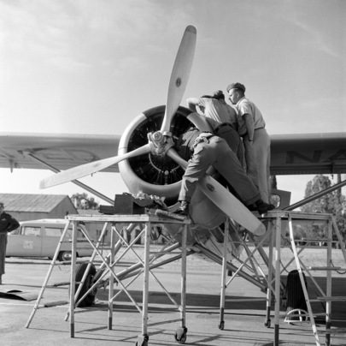
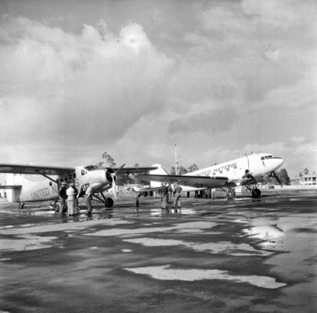
Canadian Otters as
Reconnaissance Aircraft in Sinai (UNEF)

Slide 18

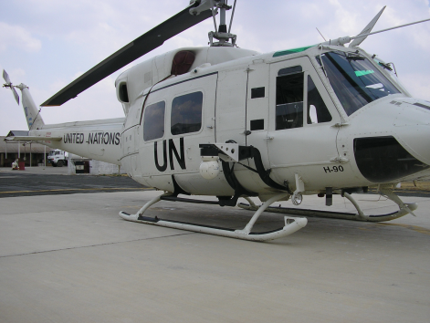
UN Peacekeeping Force in Cyprus
Argentinian Air Unit

Slide 19
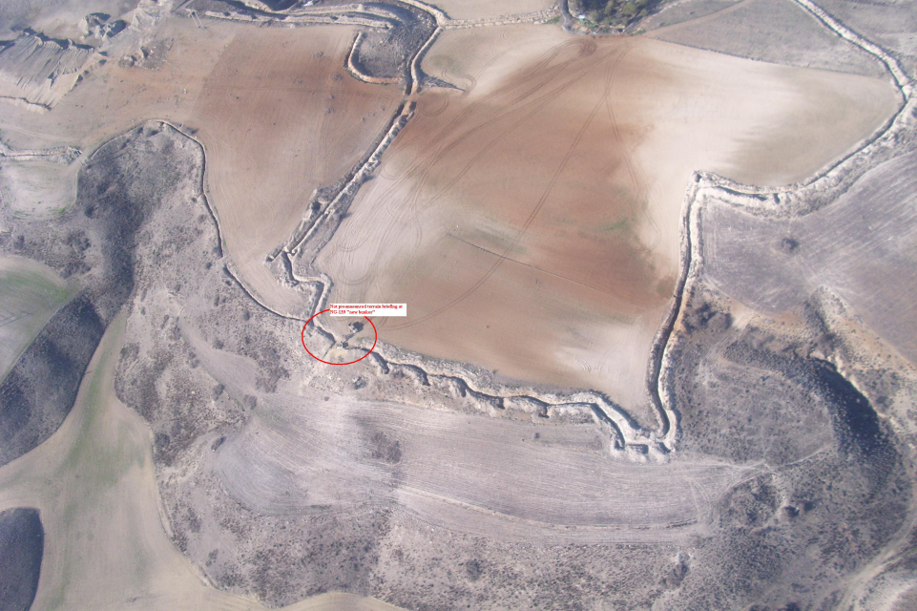
Non-announced military briefing at new bunker

Slide 20
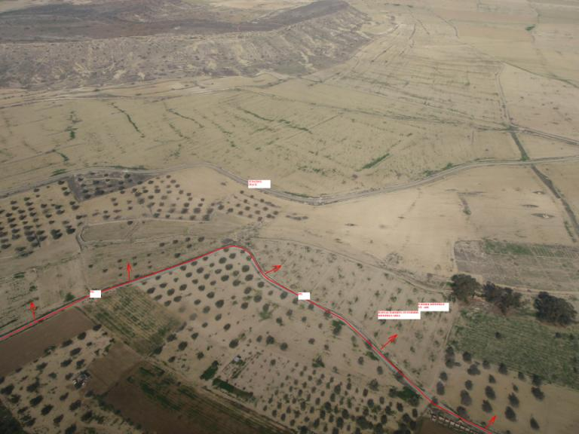
Detecting Violations: illegal farming in former minefield

Slide 21
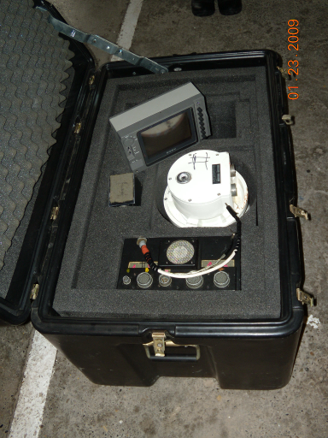
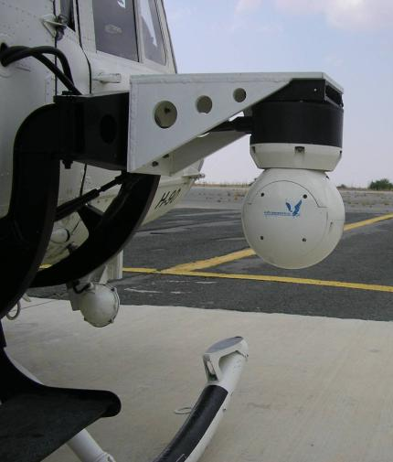
Forward-looking Infrared (FLIR) Pod
Photos by W. Dorn

Slide 22
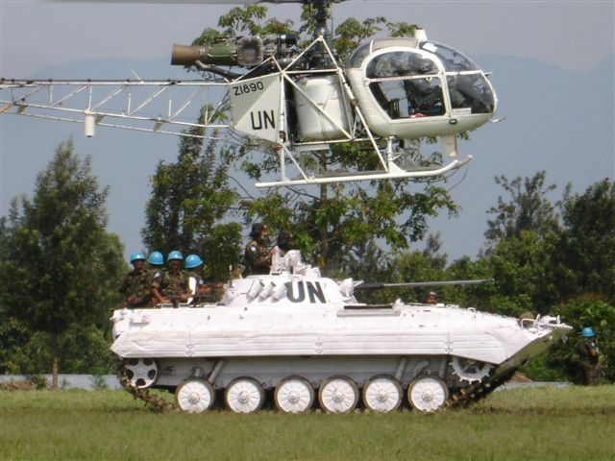
Mission in Congo
Notes:
Op Taming Turncoat
AERIAL MISSION TAKING OFF FROM RUTSHURU
sensitize FARDC against desertion to join renegade commander N’Kunda
Spotting groups of soldiers, moving in what direction

Slide 23
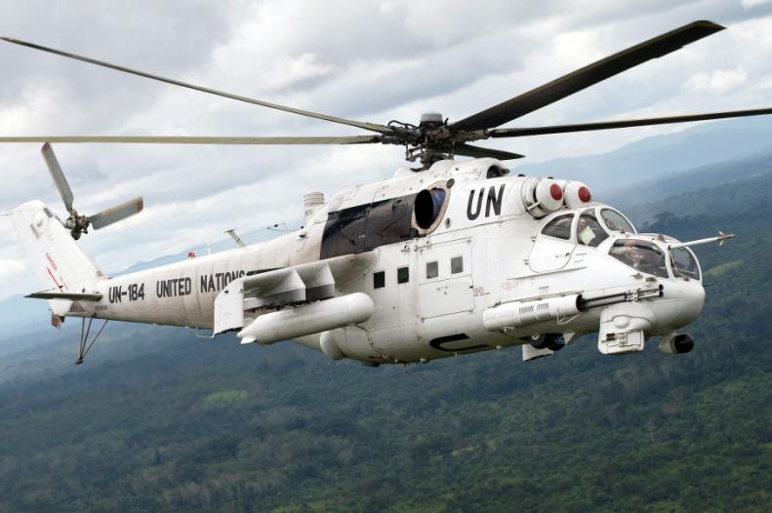
Attack Helicopter
UN Photo # 200146/C. Herwig
MI-24 Attack Helicopter in Liberia
Notes:
Side view
“UN Helicopter on Aerial Patrol
An MI-24 [export version: MI-35] helicopter of the United Nations Mission in Liberia (UNMIL) on aerial patrol in search of the illegal marijuana plantations. 17 September 2008, Monrovia, Liberia”

Slide 24
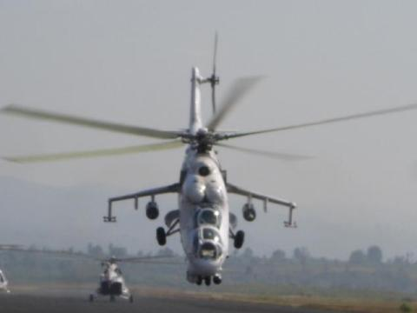
MI-35 Front View
MI-35 in MONUC, No.104 Helicopter Unit of the Indian Air Force, 21 January 2006
URL: http://www.bharat-rakshak.com/IAF/Images/Special/Features/Congo/Photo_2006123102447578.jpg.html
Notes:
Caption: Disarming FRPI militiamen in Ituri
Operation "Ituri Encourager" aims to disarm FRPI militiamen who have not yet joined the district's disarmament program despite an ultimatum to surrender before 11 January 2006.
Z-3129 / UN-859 One of Mi-25's from MONUC Indian Aviation Contingent at Goma
http://www.airliners.net/photo/United-Nations/Mil-Mi-25/0879127/M/

Slide 25
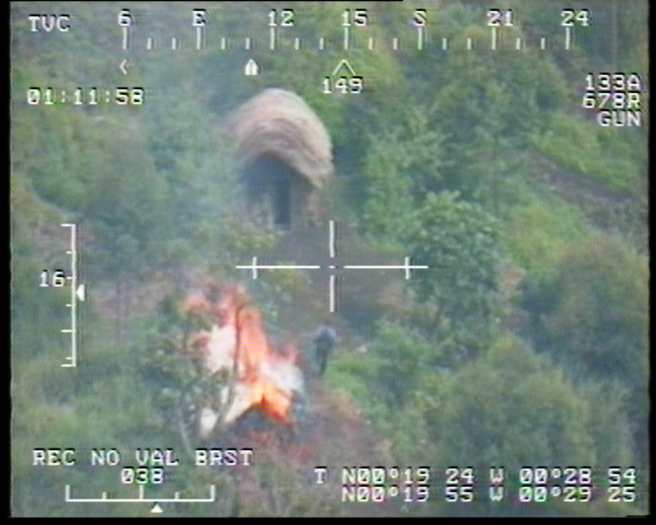
CNDP Rebel with Weapons during Attempted Attack on Goma

Slide 26
Suspected Rebels and Vehicle (FLIR Freeze Frame)

Slide 27
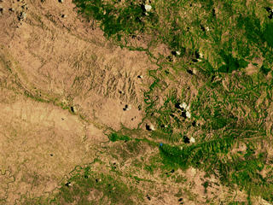
United Nations Stabilization Mission in Haiti (MINUSTAH)
Source: NASA, Landsat-5/TM (05/13/1998)

Slide 28
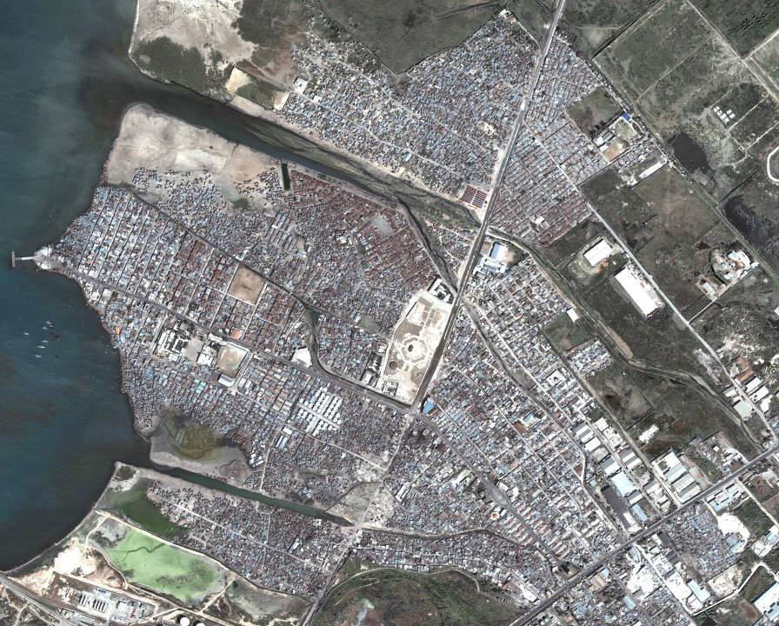
Cité Soleil, Port-au-Prince
BOIS NEUF
DROUILLARD
Vulcain St
Soleil 9 St
Ti Haiti
Blanchard
(Cite
Gerard)
Drouillard St
WAFF
Lintheau I
Lintheau II
SOLEIL 4
Cite Lumiere
Soleil 19
Soleil St
Norway
Soleil 17
Bas Shalom
Proj
Kay Boule
(Naboule)
Soleil 13
Trois
Bebes
Soleil 9
Soleil St
Ti Paul St
BROOKLIN
National #1 Rd
Volcy St
BELECOU
BOSTON
Sanon St
Boston St
Soleil 9 St
UN RESTRICTED

Slide 30
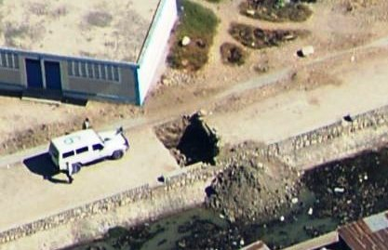
2,8 m deep
4,8 m

Slide 31
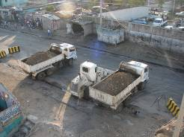
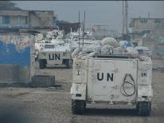
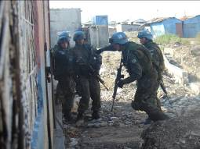
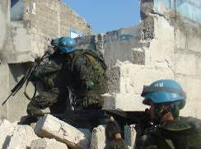

Slide 32
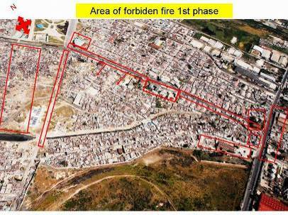

Slide 33
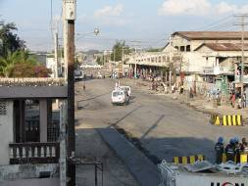
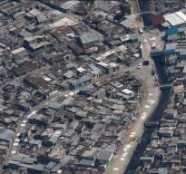

Slide 34
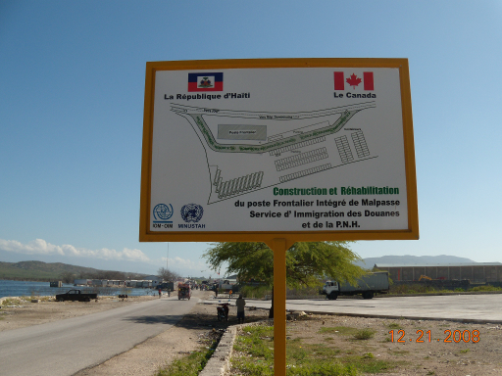
December 2008

Slide 35
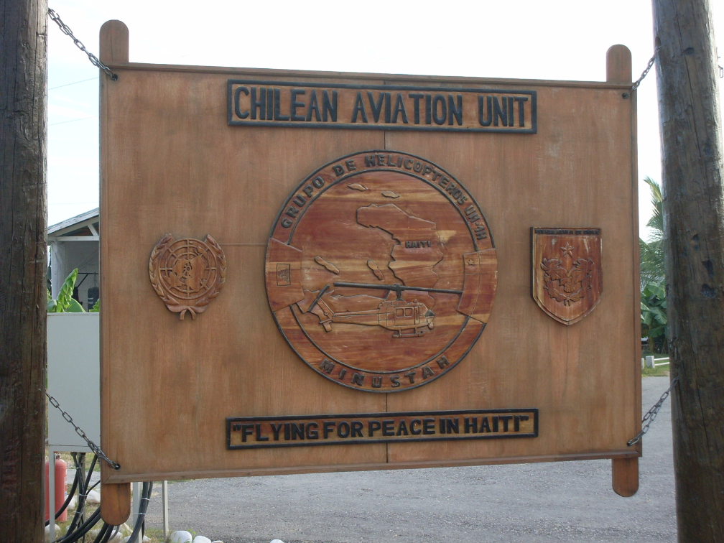

Slide 36
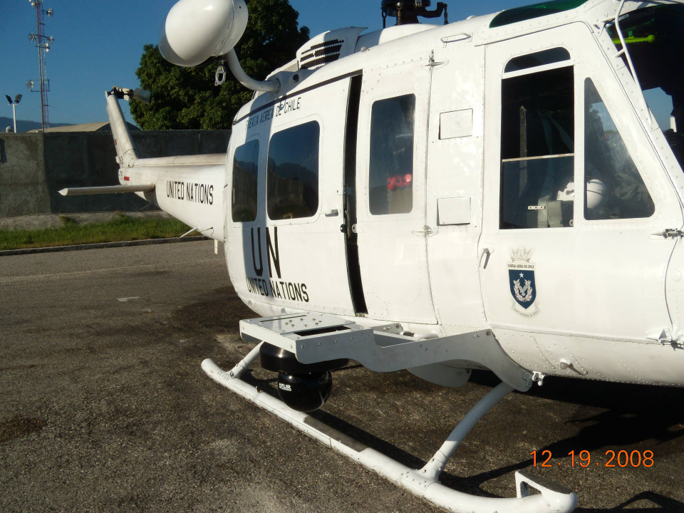

Slide 37
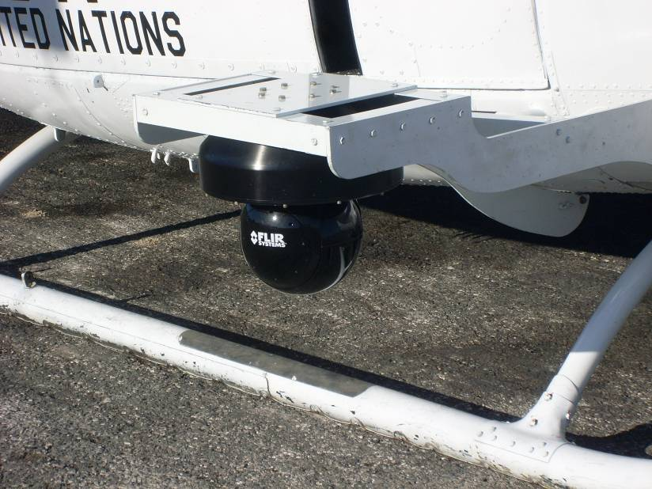

Slide 38
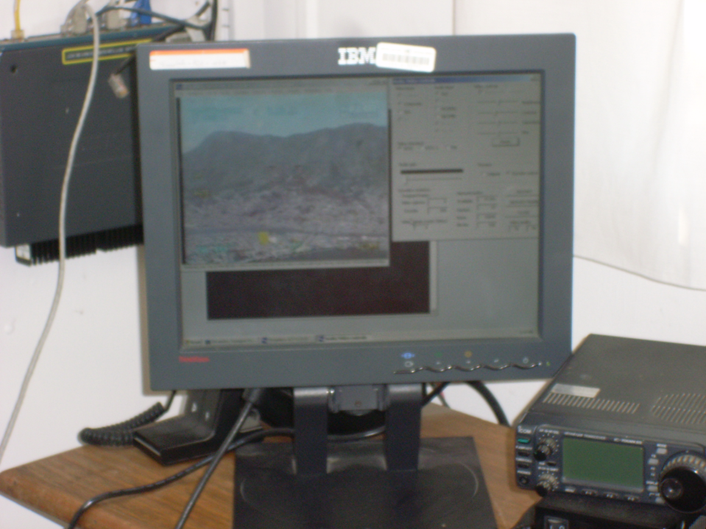
Real-time transmission from military helicopter to airfield and mission HQ

Slide 39
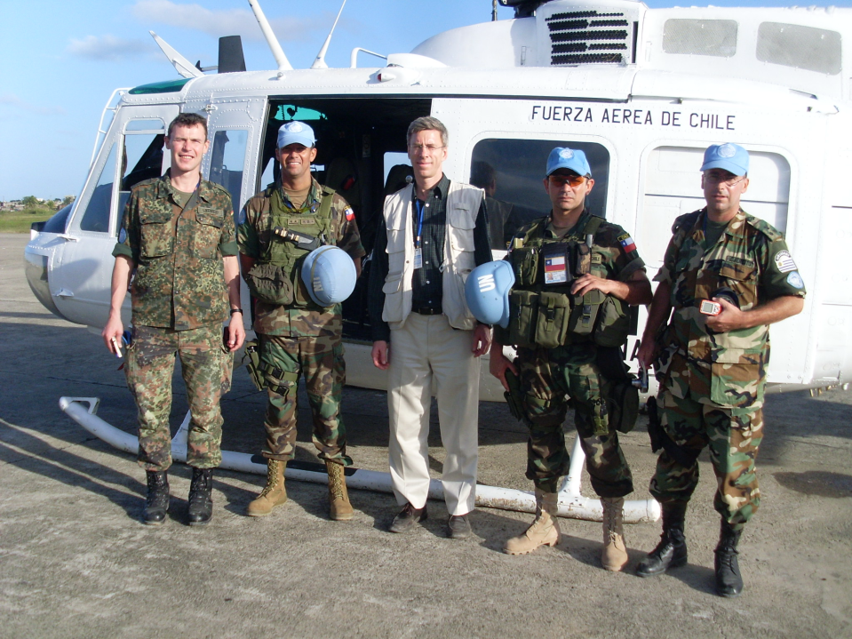

Slide 40
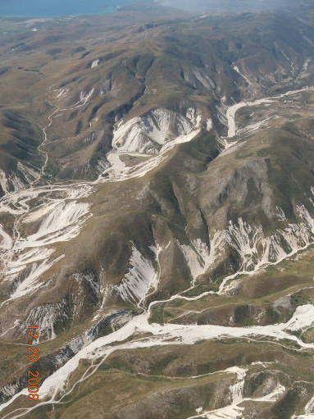

Slide 41
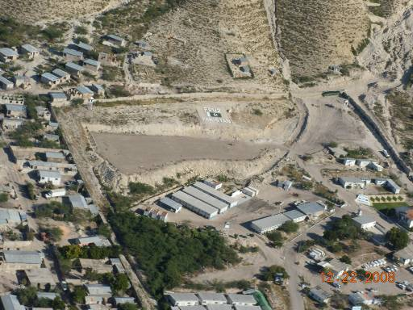

Slide 42
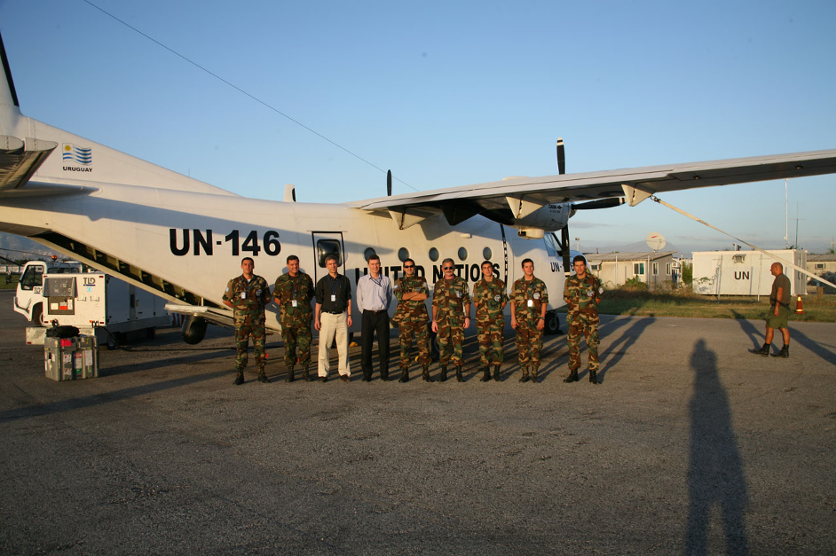
Uruguayan CASA-212 Aviocar for observation, transport, medevac
(Dorn in khaki pants)

Slide 43
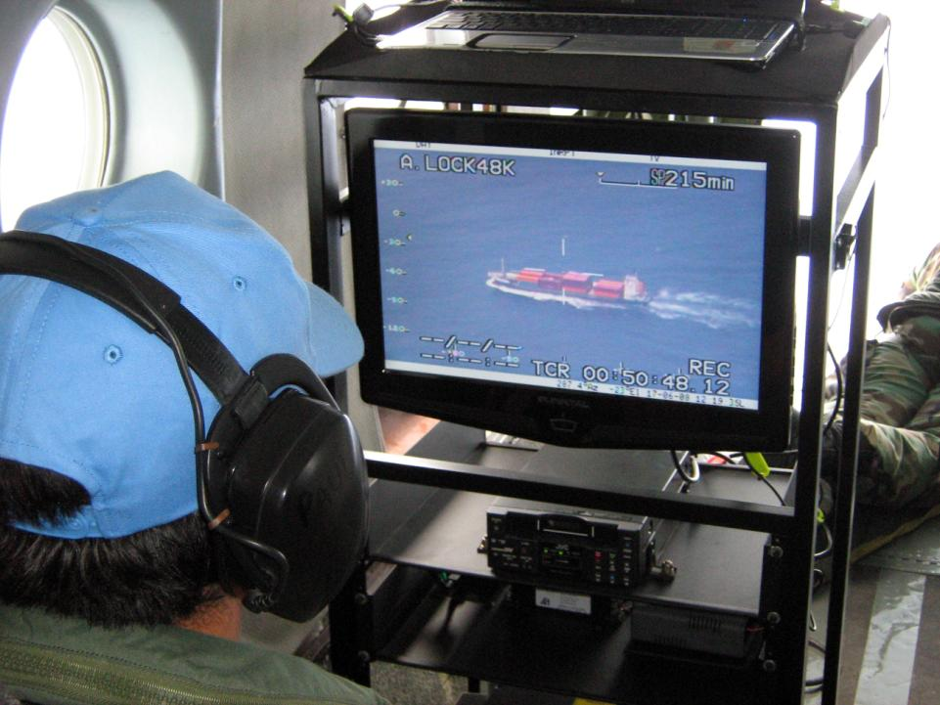
Notes:
43

Slide 44
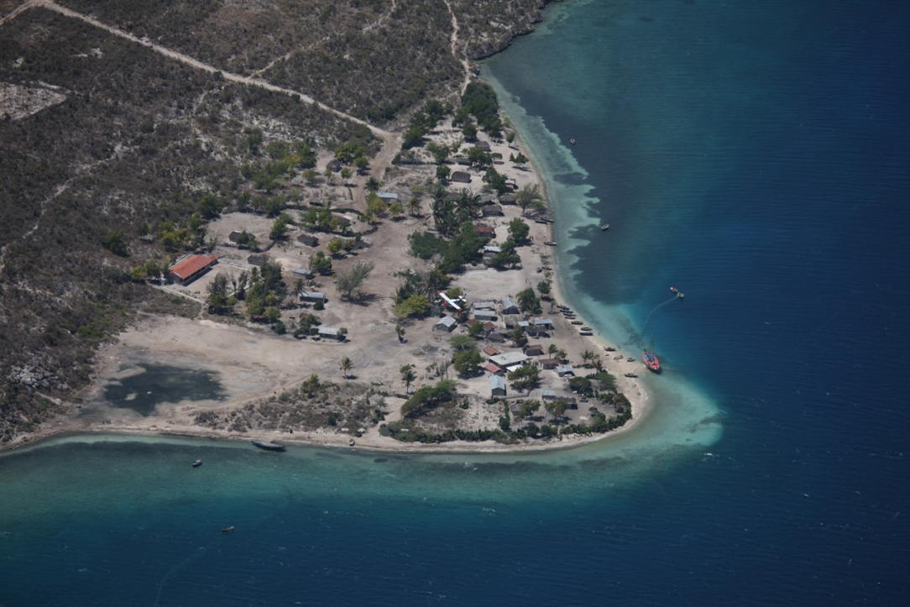
Following Aircraft
Notes:
44

Slide 45
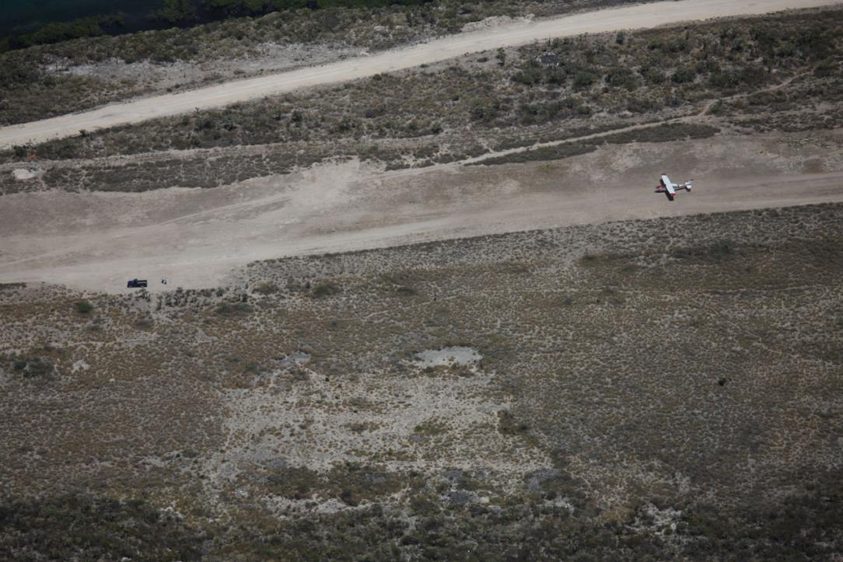
Notes:
45

Slide 46
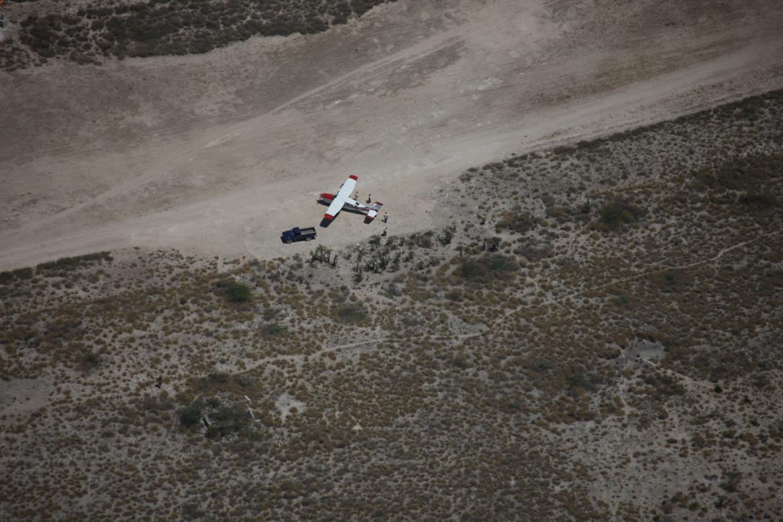
Notes:
46

Slide 47
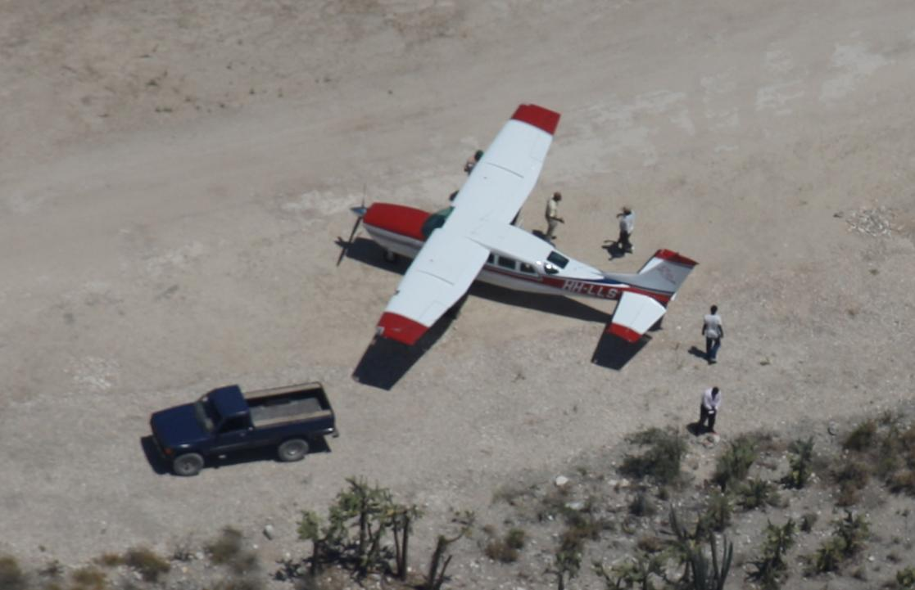
Notes:
47

Slide 48
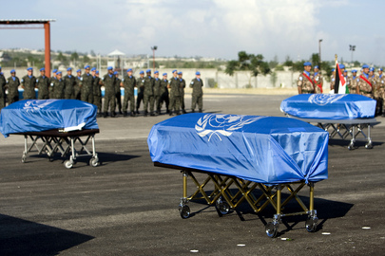
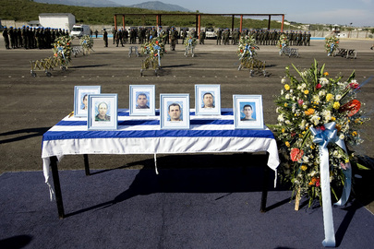
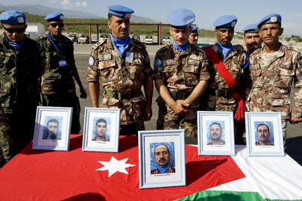
Casa-212 Crash (2009)

Slide 49
Unmanned (vs Manned)
Safety and security
  Accident or attack
  Peacekeeper’s dilemma
Night flying
Smaller, lighter
  Endurance: range and loitre on station
  Easier to hide, harder to shoot
  Launch locations
Expense
Personnel location
  Shift work
Notes:
UAVs deal with unexplored areas of nation and international law that can be used (and misused in the case of assassin drones).

Slide 50
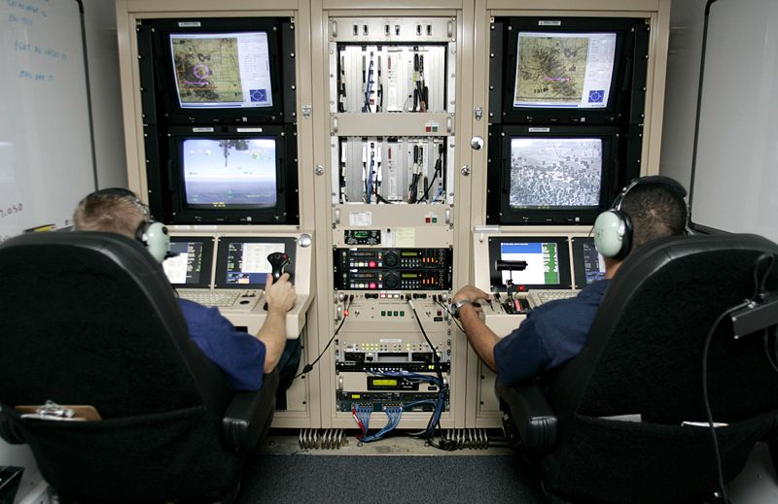
Piloting UAVs

Slide 51
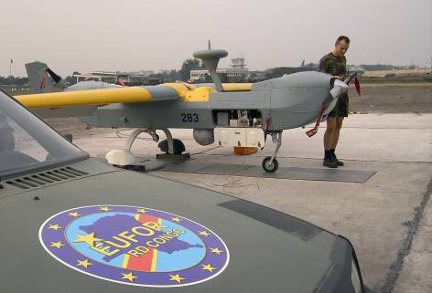

EUFOR UAV Support to MONUC (2006)
B-Hunter
Belgian contribution to EUFOR
Israel Aircraft Industries
Bosnia (2005) 400 flight hrs
DRC (2006) 300 flight hrs

Slide 52

Congolese arms race
President Kabila vs
Vice-President Bemba
Tanks shipped by rail
Dugout canoes filled with small arms across Congo River

Slide 53


Kinshasa, 20-22 August 2006

Slide 54



Slide 55


2006
Operational problems
  1 shot down
  1 crashed, causing fatalities on ground
  Info-sharing EUFOR/UN
Political problems
  Host-state info demands

Slide 56






UAV Proliferation
Israeli
American
Australian
Hand launched
Canadian
Japanese

Slide 57
Contracted UAS by UN
Request for Proposal
6 UAVs, 2 ground segments (Goma and Bunia)
10-12 hrs per day; surge 72+ hrs (crisis)
Camera: day&night, 2 m at 5 km slant range; growth to SIGINT and SAR
RVT to forward units - training from contractors
Budget of $22 million per year for 4-5 years
30+ EOIs; 6 bids

Slide 58
Contracted UAS
Government of DR Congo (GoDRC)
  Accepted in 2009
  Questioned missions (MONUSCO)
Mission doubts UAV feasibility & cost-effectiveness
  Manned helicopters preferred
Renewed effort
  Expression of Interest (2013)

Slide 59
Overview: UN Technological Status
Aerial imagery
  No UAVs deployed by UN (yet)
  Real time video transmission to MINUSTAH Hq
  MI-35 sensors
Satellite imagery
  Not real time – limited operational utility
    Mapping
    MacDonald, Dettwiler & Assoc. (MDA)
    Electro Optical (EO) but Synthetic Aperture Radar (SAR) not used
Moving from cartography to GIS
Some nations in some missions

Slide 60
Common Limitations on
High-Tech in UN
Reliance on "volunteering" nations
  Ad hoc basis; no permanent arrangements
  Operated by nationals of that country
  When contingent withdraws goes
UN's stockpile effectively non-existent
Contractor arrangements unfulfilled
No resident UN expertise
  UNSCOM; UNMOVIC
  Exception: communications

Slide 61
Contribution of Uniformed Personnel to PKOs:
OECD and Non-OECD Nations
70
non-OECD
non-OECD
OECD
60
50
40
Number of personnel (thousands)
30
20
OECD
10
0
1993
1994
1995
1996
1997
1998
1999
2000
2001
2002
2003
2004
2005
2006
Dorn, 2007

Slide 62


Special Committee on Peacekeeping
UN Photo/Paulo Filgueiras

Slide 63
“Tools of the Trade?”
Conclusions
1. No technological fix … but airborne surveillance technology can be of immense value in monitoring, preventing and mitigating conflict.
2. Technical monitoring can increase the safety and security of peacekeepers as well as the effectiveness of the mission.
3. Technologically advanced nations are needed to provide such force enablers.
Notes:
- Technology, which has long been used in the service of war-fighting, can be used for peacekeeping, making missions more effective and safer.
This feeling was behind the C-34 request for a comprehensive examination of monitoring and surveillance technologies, request DPKO for dialogue
Commission by DPKO to make such a study.
Examined the ways in which the UN currently uses monitoring and surveillance technologies, and report I present to you today.
[Culmination of two decades of research. For this particular, work interviewed two dozens persons in the UN Secretariat, many current and former peacekeepers and visited a mission for a case study.]
The UN has tasked its peacekeepers with an immense array of monitoring tasks, from ....
What I have found in my study is a « monitoring gap » between the mandates given to UN POs and their capacity to fulfill those mandates.

Slide 64

45. The Special Committee welcomes the study launched by the Secretariat on the use of advanced monitoring and surveillance technologies to tangibly improve operational capabilities, achieve results in the field and promote the safety and security of peacekeeping personnel. Recognizing the urgent need for Peacekeeping Operations to standardize the use of advanced technology, particularly in missions operating in dangerous environments or mandated with challenging tasks, the Special Committee requests the Secretariat to develop appropriate modalities for the use of advanced monitoring and surveillance technologies with due attention to legal, operational, technical and financial considerations as well as the consent of the countries concerned with regards to their application in the field.
Report of the Special Committee on Peacekeeping, 23 May 2007; UN Doc. A/61/19

Slide 65
42. The Special Committee notes the progress made towards a wider and systemic use of technology in peacekeeping operations. However, the Special Committee believes further progress is required. In this regard, the Special Committee requests the development of a United Nations policy on monitoring and surveillance technology, and looks forward to a report on this subject within six months of the issuance of this Committee’s findings. The Special Committee believes that due attention should be given to legal, operational, technical and financial considerations and especially the consent of the countries concerned with regard to their application in the field.
2009 Substantive Session (A/63/19)

Slide 66
Challenges and Opportunities
Political
  Host state
  Sharing info
  Privacy
  “Shutter control” rules
Personnel
  Operators and analysts and users
    Training
    Deployment
Financial/Physical
  Life cycle: Purchase, Maintenance, Storage

Slide 67
UAVs are not yet
“tools of the trade” but they can and should be

Slide 68
Canada
“Key enabler”
  “Force multipliers”
Expertise
  Remote sensing community
  Peacekeeping experience

Slide 69


Canadian Coyotes in Ethiopia-Eritrea
CF Combat Camera, ISD01-0030a, Bernier, 4, 2001

Slide 70

Notes:
70

Slide 71
IF THIS TECHNOLOGY-AIDED PRESENTATION DIDN’T WORK …
FORGET EVERYTHING I SAID

