Slide 1

The UN Security Council
Dr. Walter Dorn
Canadian Forces College
21 January 2019
Notes:
Blank

Slide 2
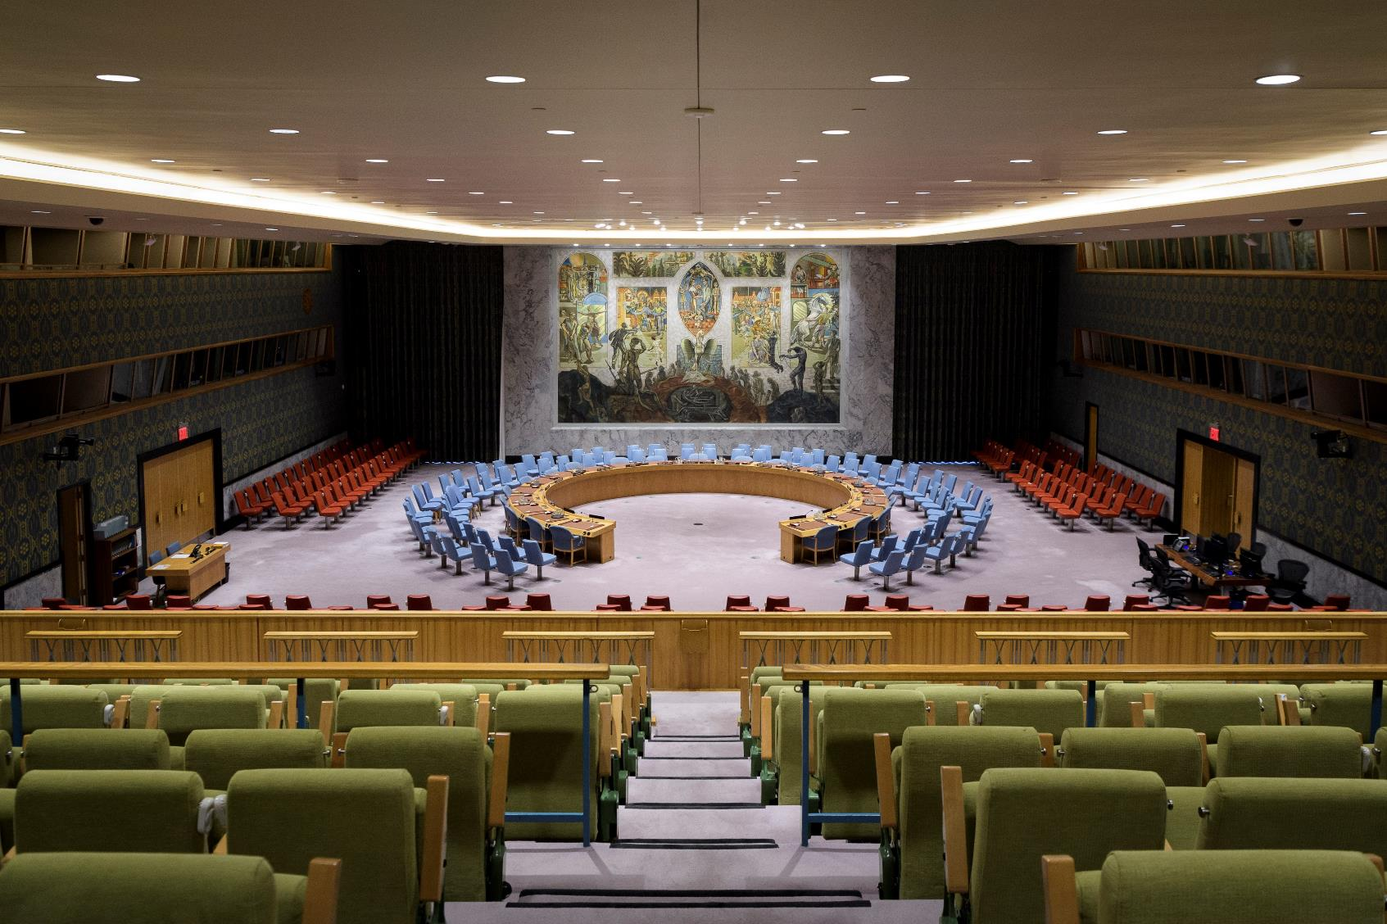
UN Photo 764010 (2018)

Slide 3
Overview
Origins
UN Charter
Structure and composition
Selected events
Canada and the SC
Final thoughts

Slide 4
Origins

Slide 5
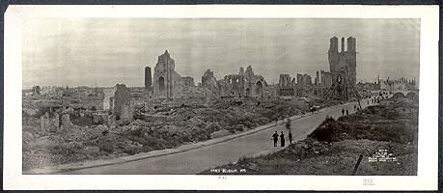
World War I
Clash of empires
Failed balance of power & “Concert of Europe”
National selfishness and militarism

Slide 6
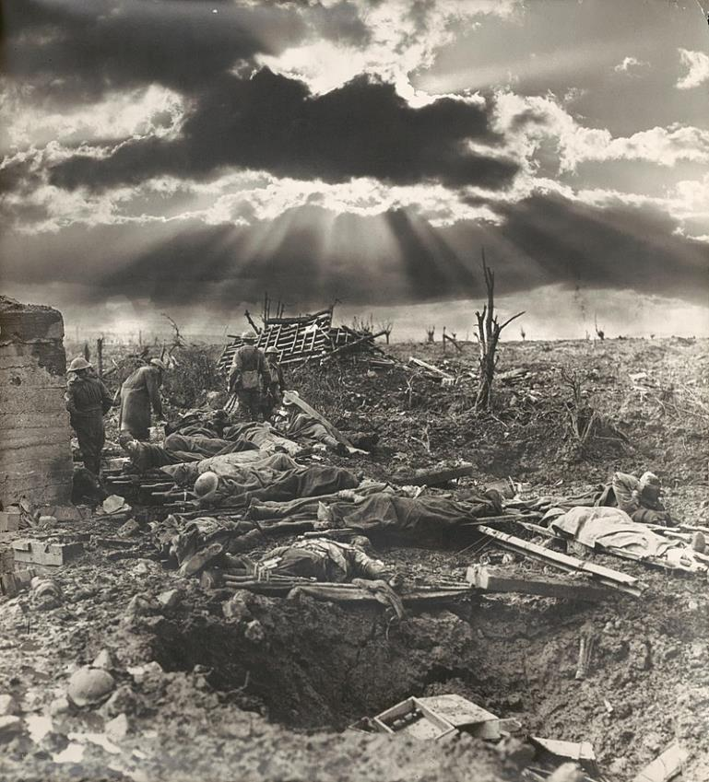
Origin of international organization (IO) for peace
  Sacrifice, progressive spirit, imperative of prevention
  From destruction, new hopes and dreams
wikimedia.org
Notes:
By Frank Hurley - National Library of Australia, file: la.pic-an24574133, Public Domain, https://commons.wikimedia.org/w/index.php?curid=1002811

Slide 7
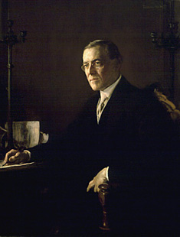
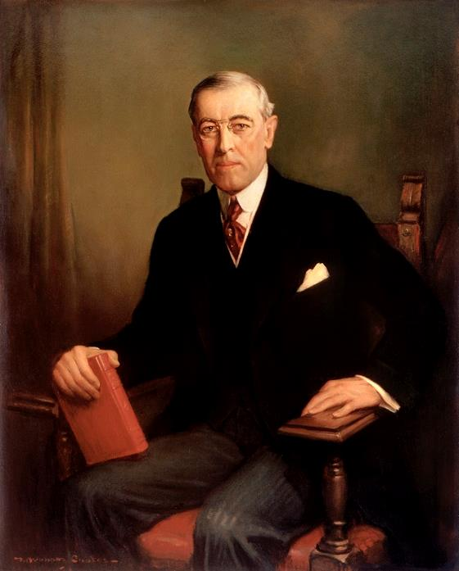
The Seed Idea
“A general association of nations must be formed under specific covenants for the purpose of affording mutual guarantees of political independence and territorial integrity to great and small states alike.”
  President Woodrow Wilson
  Fourteenth Point
  8 January 1918
https://commons.wikimedia.org/w/index.php?curid=20164350
Notes:
https://commons.wikimedia.org/w/index.php?curid=20164350

Slide 8
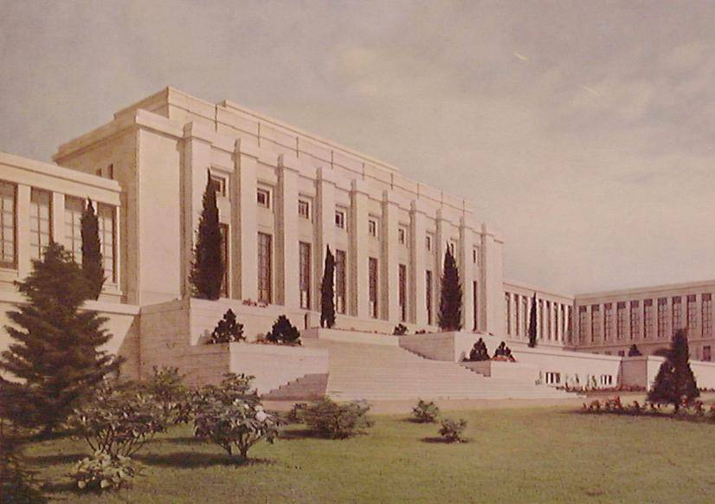
League of Nations
Palais des nations, Geneva

Slide 9
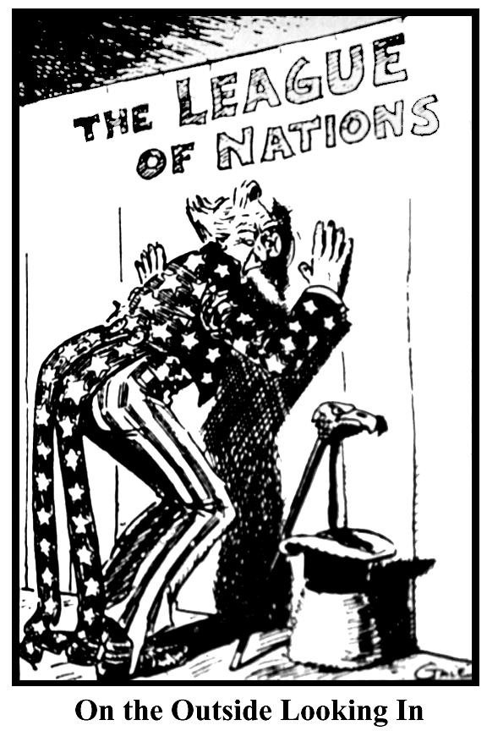
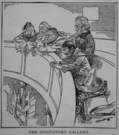
Outside the League

Slide 10
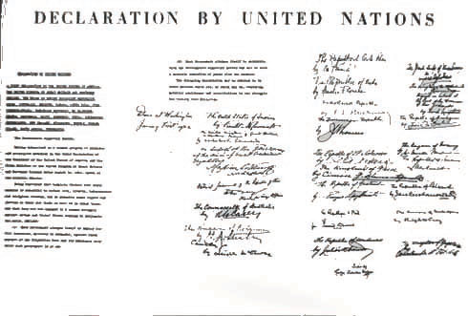
World War II
League of Nations unsupported
Declaration by United Nations (1 January 1942)
“defend life, liberty, independence and religious freedom, and to preserve human rights and justice in their own lands as well as in other lands”

Slide 11
UN Charter

Slide 12
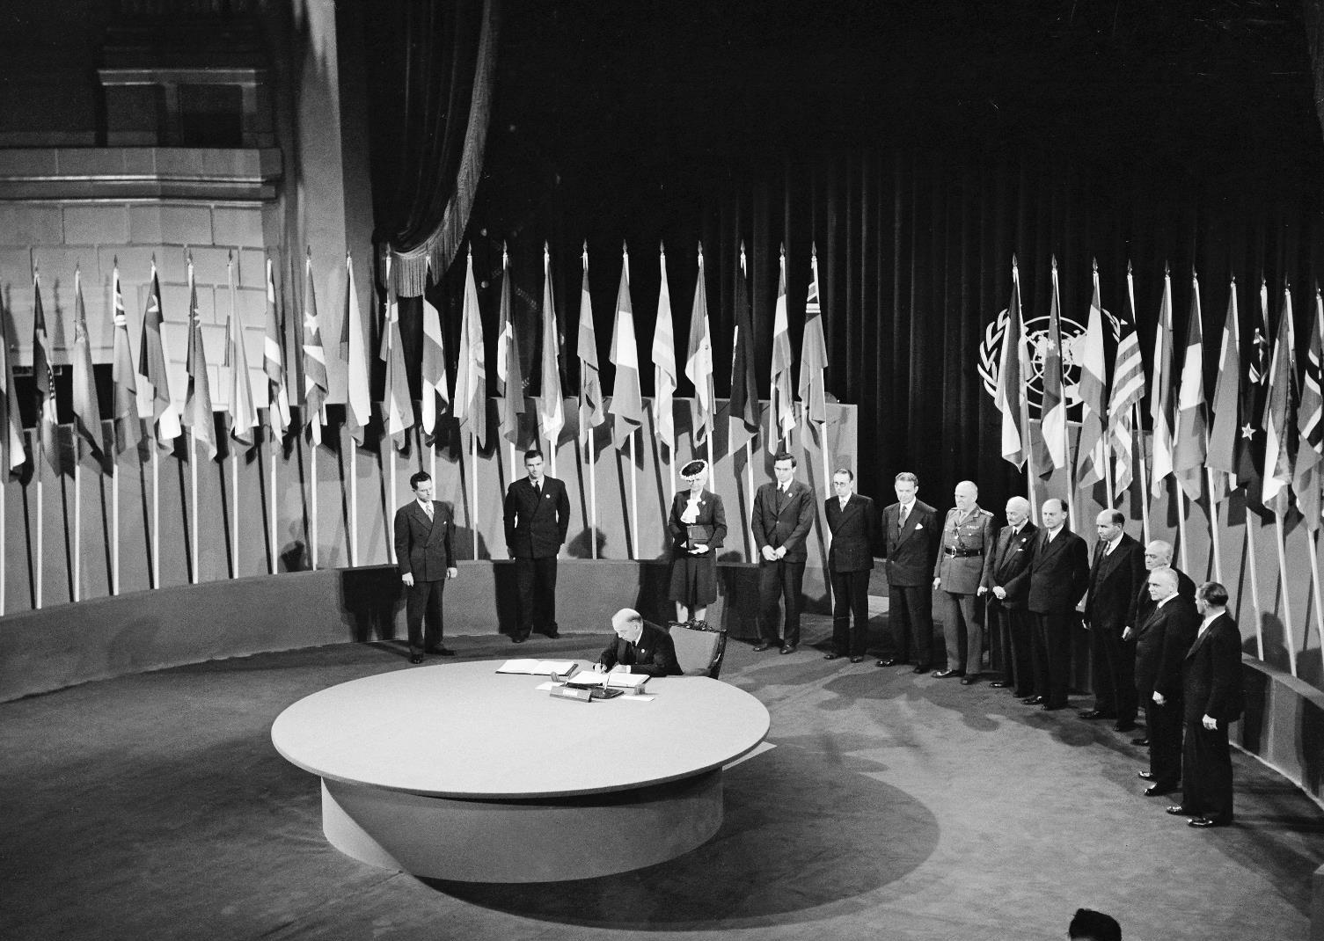
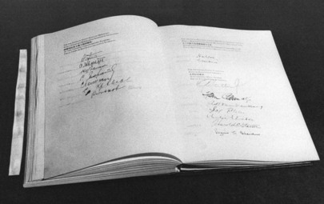
UN Photo 84214
Notes:
The San Francisco Conference, 25 April - 26 June 1945: Canada Signs the United Nations Charter
W. L. Mackenzie King, M.P., Prime Minister of Canada; President of the Privy Council and Secretary of State for External Affairs; Chairman of the Delegation from Canada, signing the UN Charter at a ceremony held at the Veterans' War Memorial Building on 26 June 1945. 26 June 1945
San Francisco, United States. Photo # 84214

Slide 13
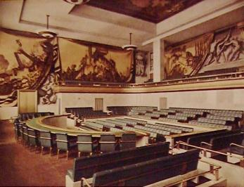
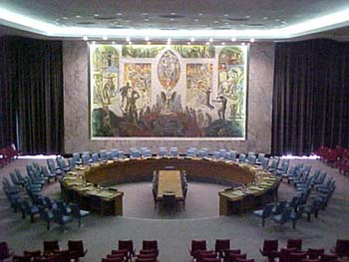
From League to UN
Council
Four permanent:
France, Italy, Japan & UK
Security Council
Five permanent:
China, France, UK, USA, USSR/Russia

Slide 14
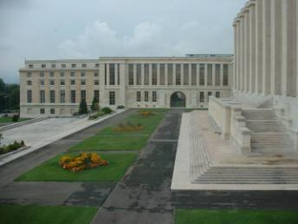
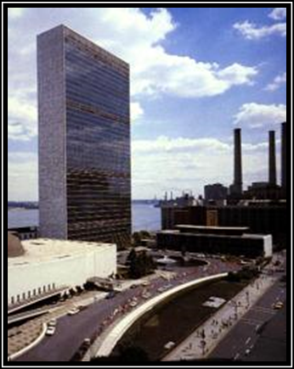
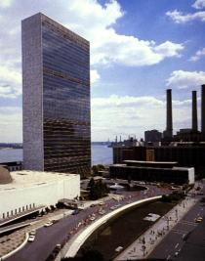
Secretariat
Geneva
Palais des Nations
New York
Headquarters

Slide 15

Charter of the United Nations
Preamble
I: Purposes and Principles
II: Membership
III: Organs
IV: The General Assembly
V: The Security Council
VI: Pacific Settlement of Disputes
VII: Action with Respect to Threats to the Peace, Breaches of the Peace and Acts of Aggression
VIII: Regional Arrangements . . .

Slide 16
Article 2, Para 4
2(4): All Members shall refrain in their international relations from the threat or use of force against the territorial integrity or political independence of any state...
http://www.un.org/en/sections/un-charter

Slide 17
Article 24
24(1): … Members confer on the Security Council primary responsibility for the maintenance of international peace and security ...

Slide 18
Article 25
The Members of the United Nations agree to accept and carry out the decisions of the Security Council in accordance with the present Charter.

Slide 19
Article 42
Should the Security Council consider that measures provided for in Article 41 would be inadequate or have proved to be inadequate, it may take such action by air, sea, or land forces as may be necessary to maintain or restore international peace and security. …

Slide 20
Article 50
Nothing in the present Charter shall impair the inherent right of individual or collective self-defence if an armed attack occurs against a Member of the United Nations, until the Security Council has taken measures necessary to maintain international peace and security.

Slide 21
Structure & Composition

Slide 22
Article 23 (para. 1)
The Security Council shall consist of fifteen Members of the United Nations. [China, France, USSR, UK, and USA] shall be permanent members of the Security Council.
The General Assembly shall elect ten other Members of the United Nations to be non-permanent members of the Security Council, due regard being specially paid, in the first instance to the contribution of Members of the United Nations to the maintenance of international peace and security and to the other purposes of the Organization, and also to equitable geographical distribution. …

Slide 23
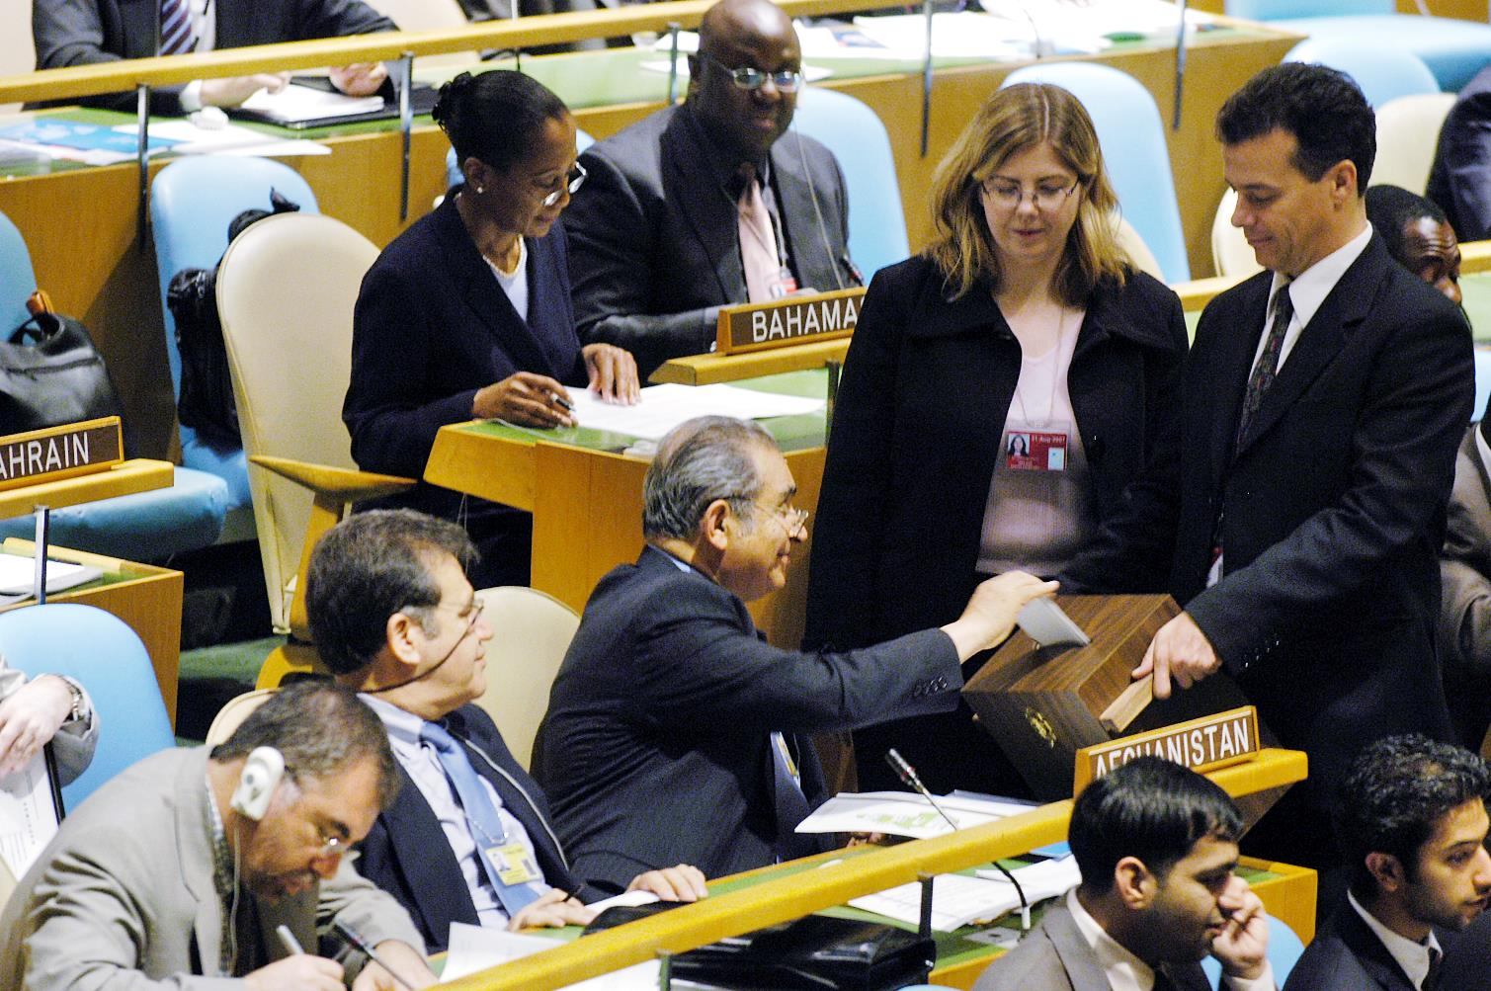
General Assembly Meets to Discuss Election of Five Non-Permanent Members of the Security Council
A delegate votes on the five non-permanent members of the Security Council. 15 October 2004, UN Photo # 51103

Slide 24
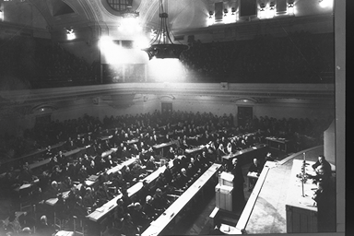
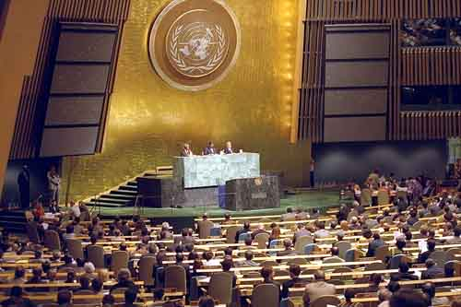
The Assembly: all membres
League
Assembly
UN
General Assembly

Slide 25
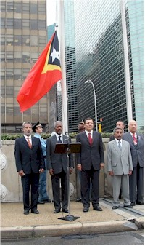
Universality of UN membership
Most recent:
Timor Leste
Montenegro
South Sudan
Timor Leste, 27 Sept 2002

Slide 26
SC Non-permanent (“elected”) Members
UN Charter amendment (Dec 1963):
Non-permanent members from 6 to 10
  3 Africa
  2 Asia
  1 Eastern Europe
  2 Latin America and Caribbean
  2 Western Europe and Others Group
  (WEOG)
http://www.un.org/Depts/DGACM/RegionalGroups.shtml

Slide 27
Western Europe and Others Group (WEOG)
Andorra Australia Austria Belgium Canada Denmark Finland France Germany Greece | Iceland Ireland Israel* Italy Liechtenstein Luxembourg Malta Monaco Netherlands New Zealand | Norway Portugal San Marino Spain Sweden Switzerland Turkey* United Kingdom United States of America*
2021-22 Election: Canada, Ireland, Norway

Slide 28
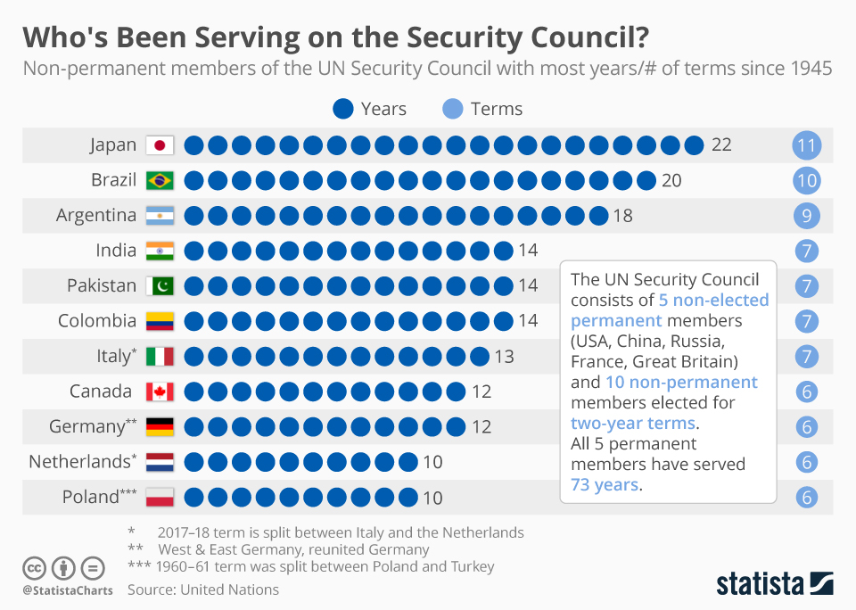

Slide 32
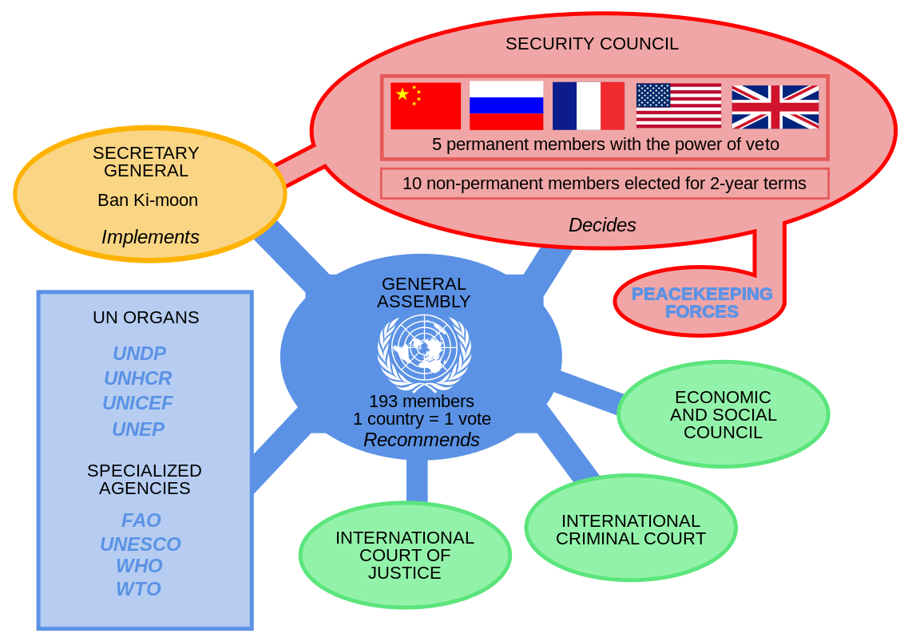

Slide 33
Selected Events

Slide 34
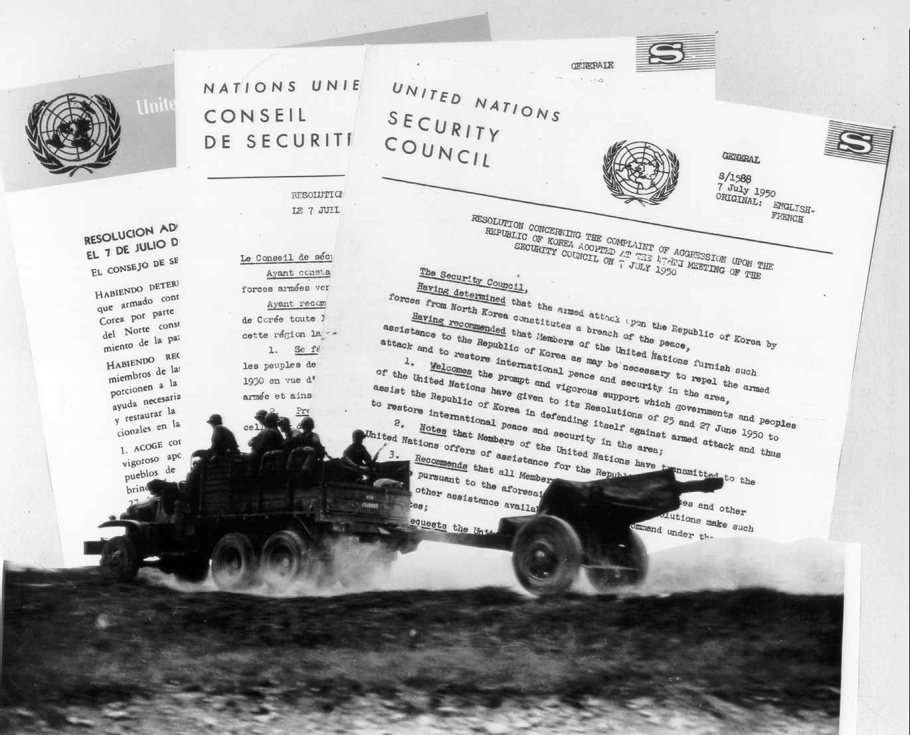
“Police Action” in Korea 1950
Vindication of Collective Security

Slide 35
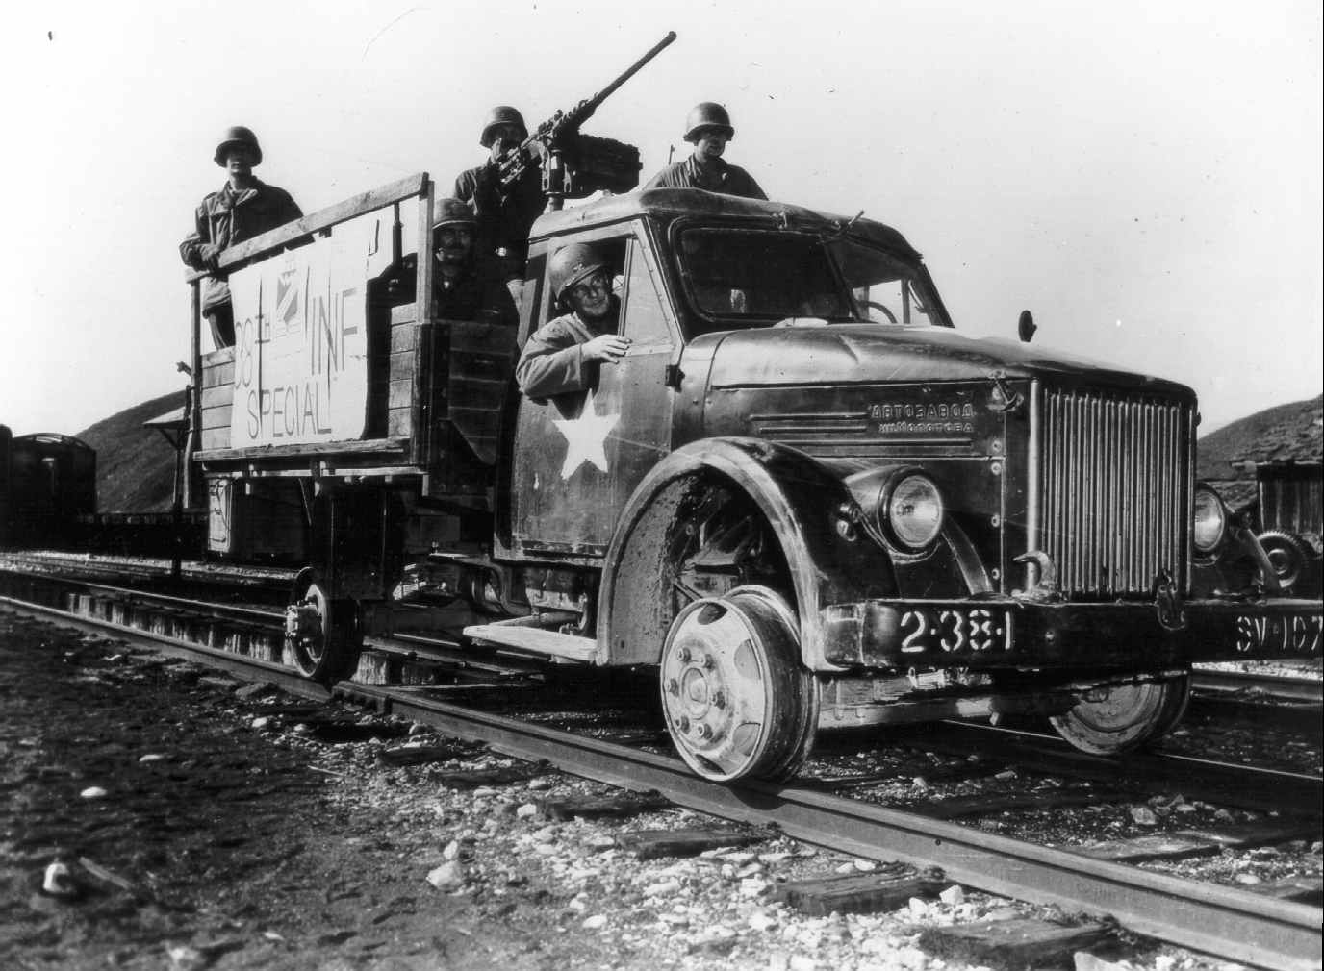
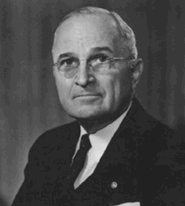
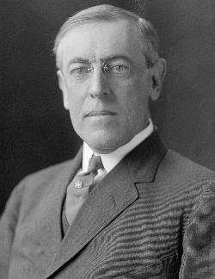
US Leadership
UN

Slide 36
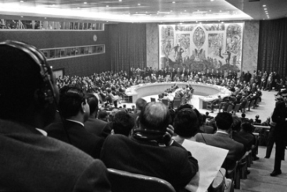
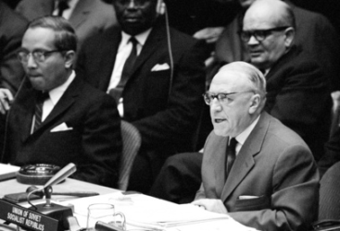
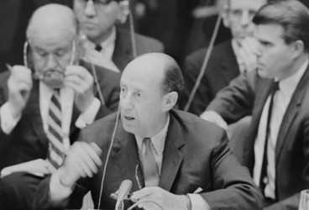
Cuban Missile Crisis
October 1962
Stephenson-Zorin,
Security Council debate
– October 25
Notes:
http://www.youtube.com/watch?v=MSV9_J8Csts
http://www.youtube.com/watch?v=MSV9_J8Csts&playnext=1&list=PL322715D051422FE3&feature=results_main

Slide 37
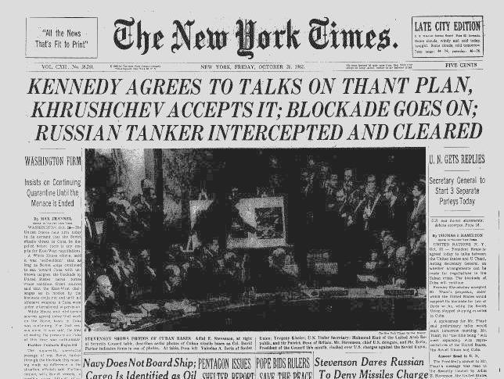

Slide 38
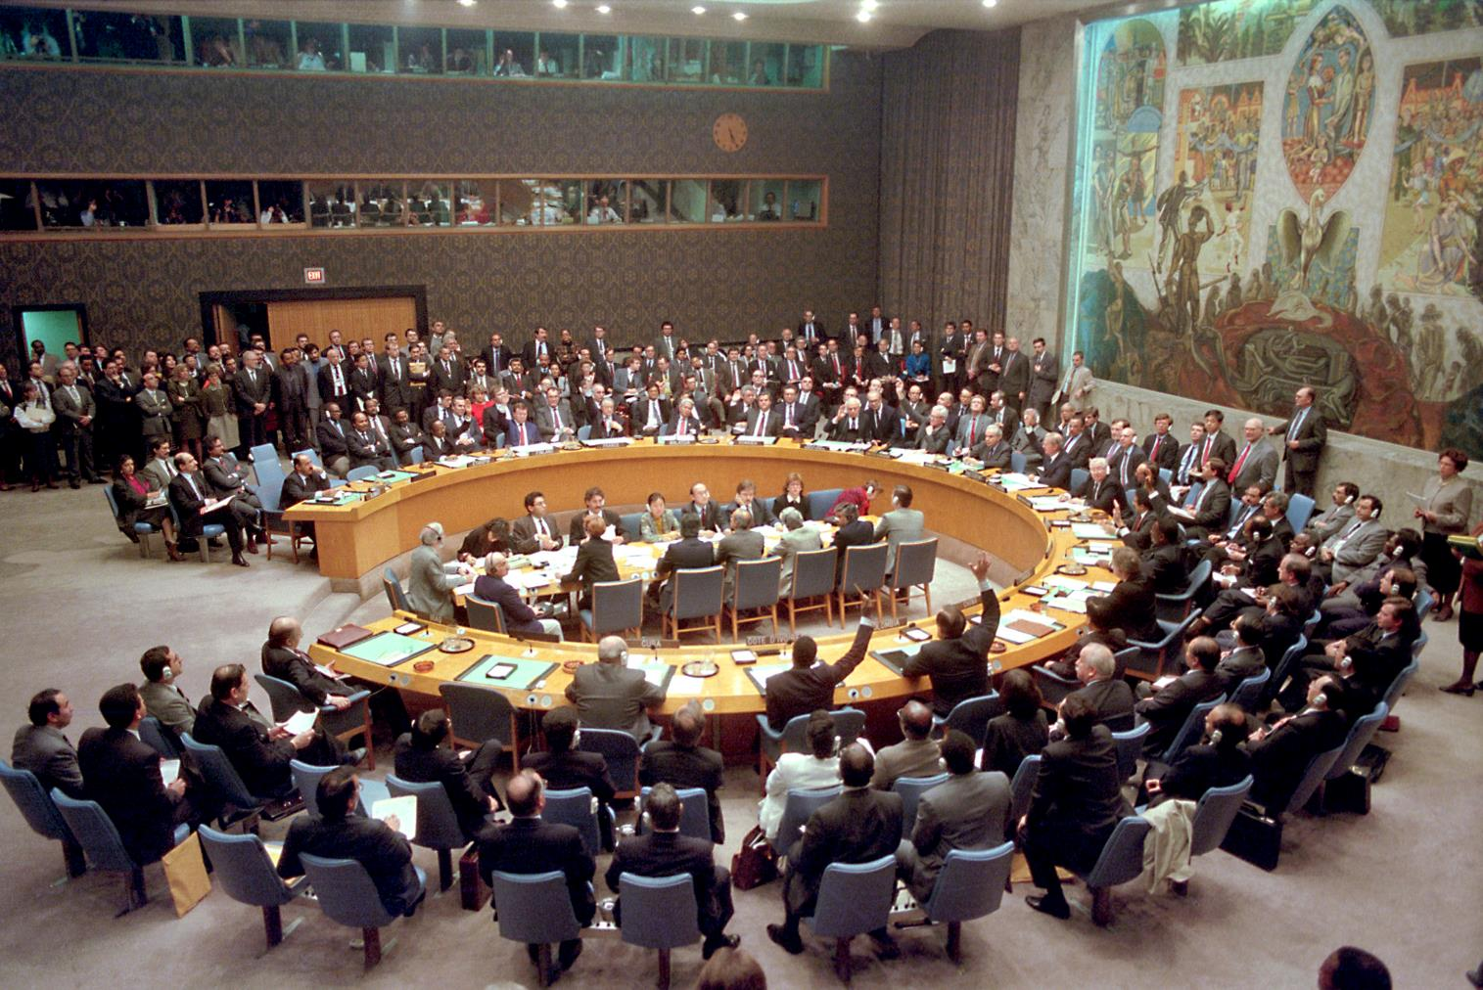
SC votes on Resolution 678 ("all necessary means” to uphold its resolutions, if Iraq does not withdraw from Kuwait)
29 November 1990, UN Photo 31700

Slide 39
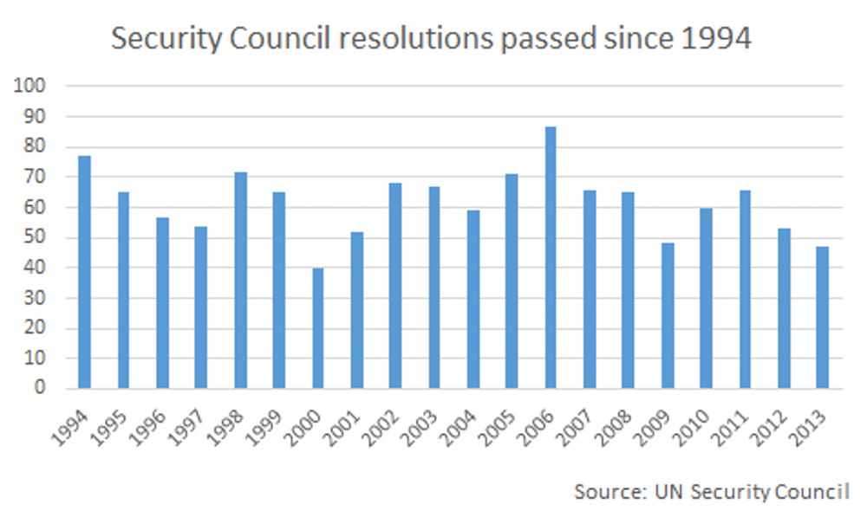

Slide 40
Peace Enforcement: Types
Sanctions
  Monitoring compliance; assessing impact
  Military role
Enforcement (Military Action)
  Gulf War (1991), Kosovo Bombing (1999, without SC resolution), Libya (2011)
Coercive Disarmament
  UNSCOM/UNMOVIC: Intelligence-sharing issues
Notes:
Arab States (1948), North Korea (1950), Congo(1961), Portuguese Government (1963), South Africa (1963), Southern Rhodesia (1965), Iraq(1990), former Yugoslavia (1991), Somalia (1992), Libya (1992), Liberia (1992), Cambodia (1992), Haiti (1993), Armenia-Azerbaijan (1993), Angola/UNITA (1993), Georgia(1993), Rwanda (1994), Sudan (1996), Sierra Leone (1997), etc.

Slide 41
Sanctions
Sanctions committees
  Only two committees to 1990: South Africa (1963-94), S. Rhodesia (1965-79)
  Ten in 1990s: Iraq (1990-), former Yugoslavia (1992-98), Somalia (1992-94), Libya (1992-94), Liberia (1992-97), Haiti 1993-94), Angola/UNITA (1993-), Rwanda (1994-98), Sierra Leone (1997-), Afghanistan (1999-)
  Many in 2000-2010: Eritrea-Ethiopia (2000-01), Liberia (2001); Iran (2006-); Libya (2011); …
National submissions
  Over 40,000 communications in one year
Sanctions Enforcement Support Teams
  Neighboring countries

Slide 42


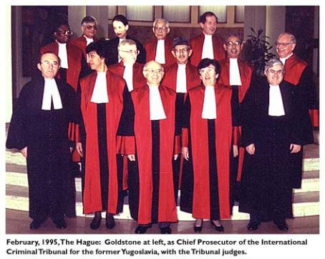

International Criminal Tribunals
& Court
ICTY (1993-2017) ICTR (1994-2015)
ICC (2002-)

Slide 43
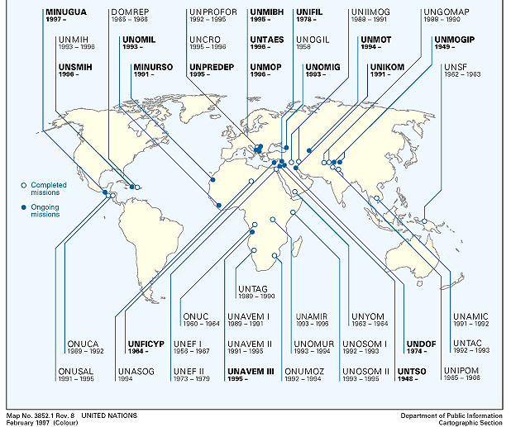
Peace Operations: 20th Century

Slide 44
Uniformed Personnel in UN Peacekeeping

Slide 45
Peace Operations today

Slide 46
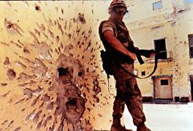

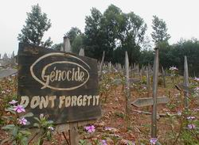
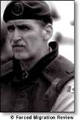
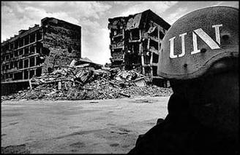

Difficult Situations 1993-95
Somalia
Rwanda
Bosnia

Slide 47
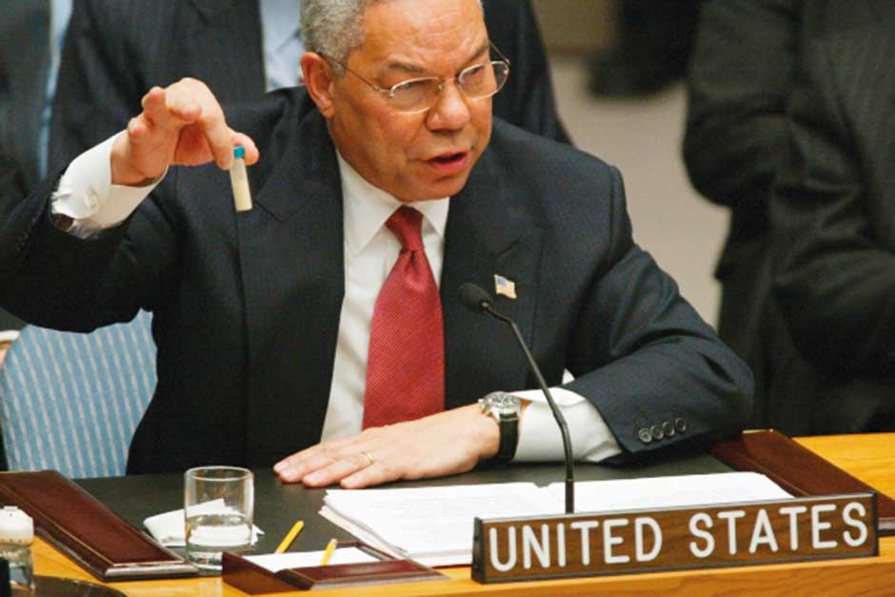
US Secretary of State Colin Powell holds up a vial that he described as one that could contain anthrax
5 February 2003

Slide 48
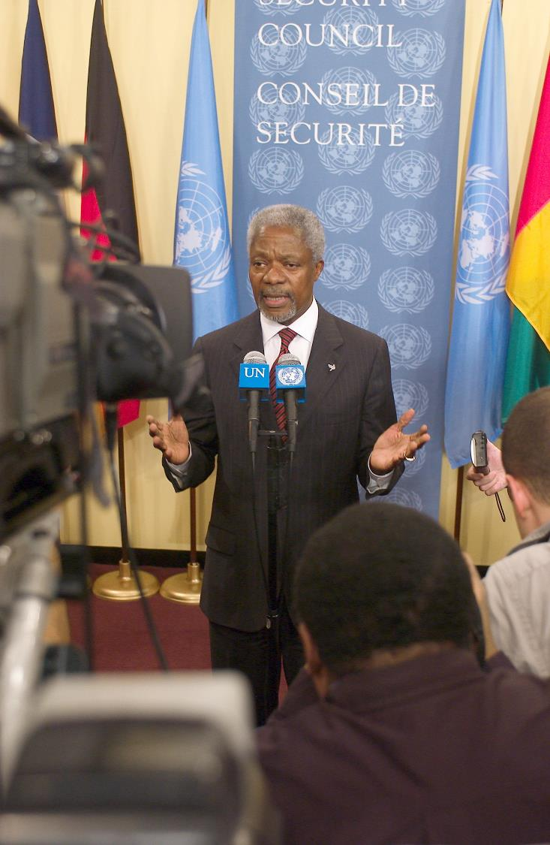
Notes:
United Kingdom, United States and Spain Won't Seek Vote on Draft Resolution
They reserved the right to take their own steps to secure that country's disarmament, it was announced this morning.
Secretary-General Kofi Annan (centre) briefs correspondents at the Security Council stakeout.
17 March 2003
Photo # 25142

Slide 49
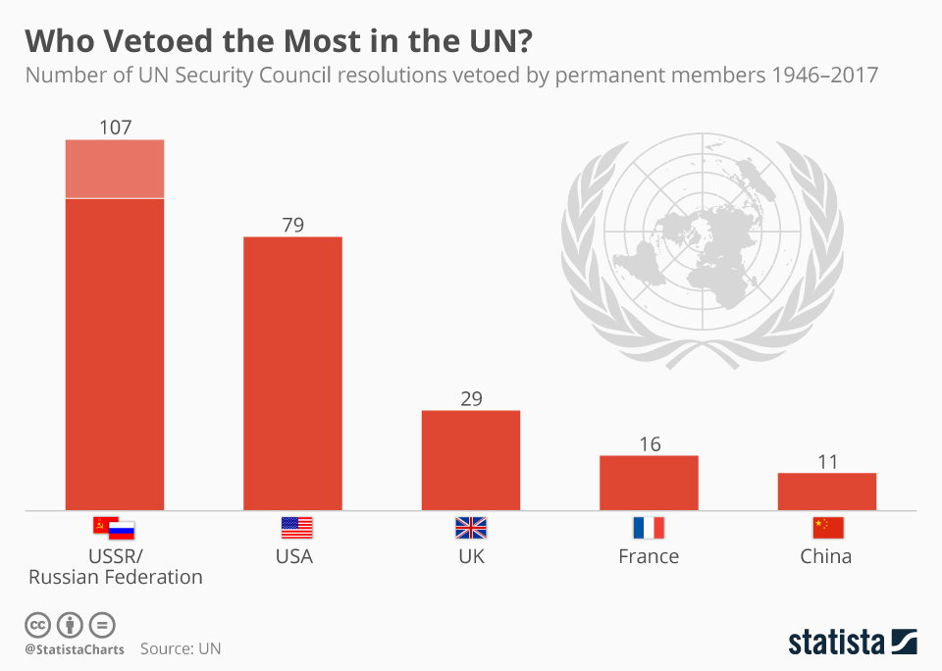

Slide 50
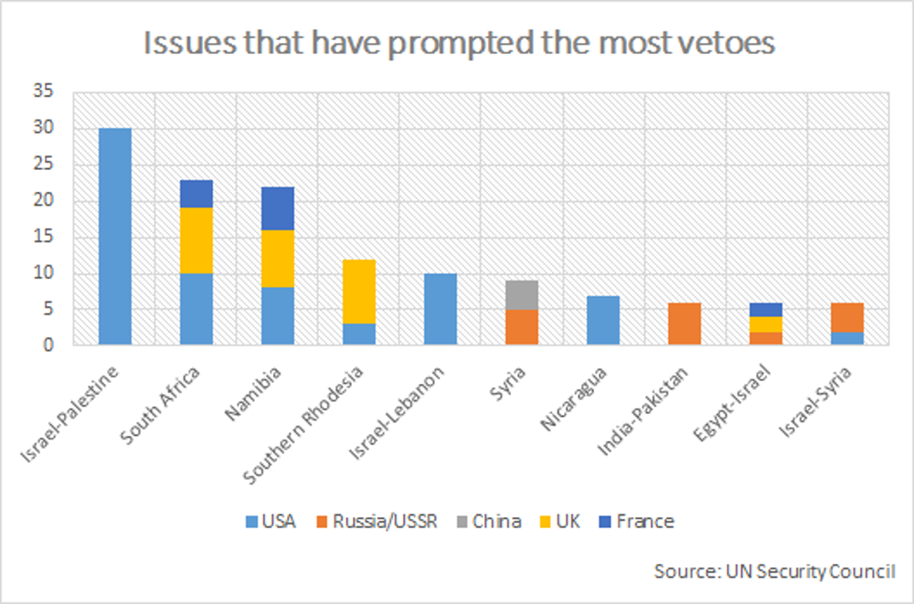

Slide 51
Canada and the UN SC

Slide 52
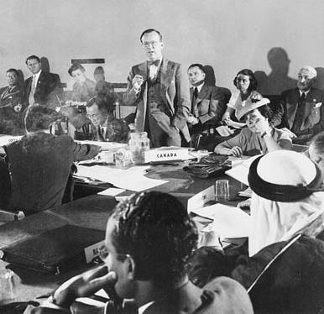
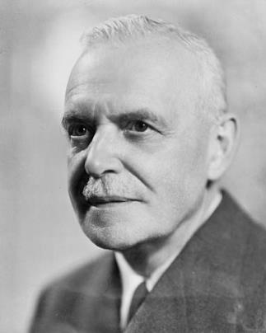
San Francisco 1945
1948-57

Slide 53
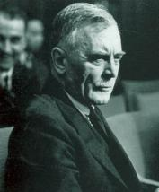
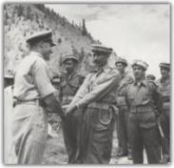
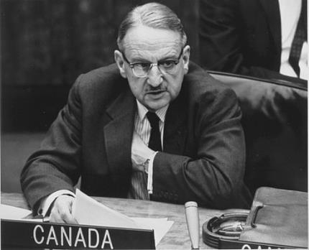
“Golden Age” of Canadian Diplomacy
General Andrew McNaughton
  Canada's first permanent delegate to UN in New York, 1948; Security Council President, 1949
Brig. Harry Angle
  Chief Military Observer, UNMOGIP, July 1950
  First Canadian to die in a peacekeeping mission
Lt. Gen. Tommy Burns
  Chief of Staff, UNTSO, 1955-56
  First Commander, UN Emergency Force, 1956-59

Slide 54
Nobel Peace Prize 1957
  Lester B. Pearson
  Oslo, 11 décembre 1957
Notes:
for the role that he played to end the Suez conflict and to resolve the question of the Middle East through the United Nations [?]
« décerné principalement pour le rôle qu’il a joué en vue de mettre fin au conflit du canal de Suez et de résoudre la question du Moyen-Orient par l’intermédiaire des Nations Unies. » [Traduction]
– Norwegian Nobel Committee

Slide 55
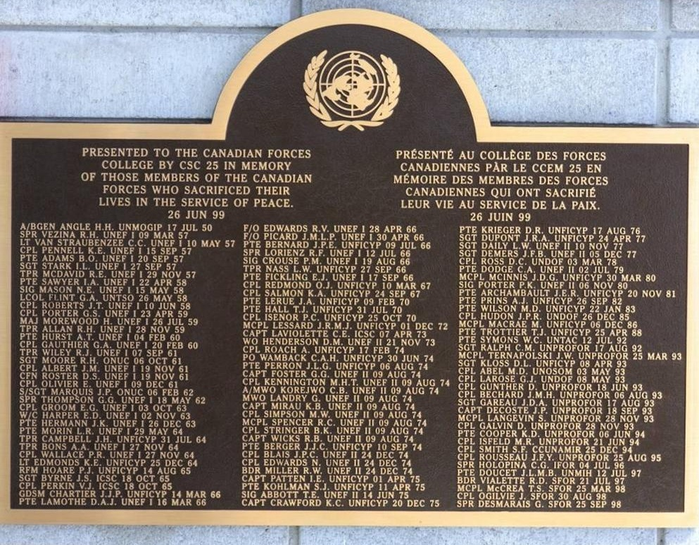
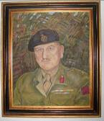
“We Remember”
Dorn
Gift of CSC 25
Sgt Barber

Slide 56
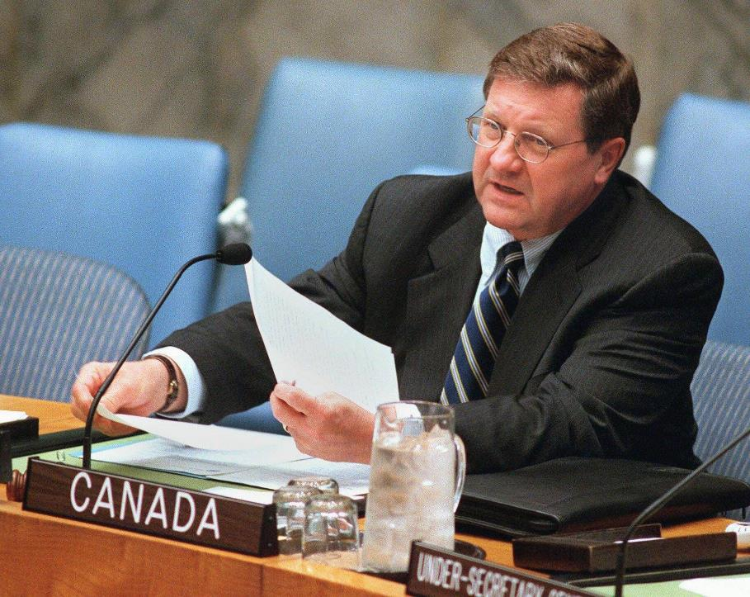
On the Council
(1946)
1948-49
1958-59
1967-68
1977-78
1989-90
1999-00
(2010)

Slide 57

Security Council President Robert Fowler (Canada) confers with Secretary-General Kofi Annan (left), prior to reading out a presidential statement on the situation between Ethiopia and Eritrea.
UN Photo 320739
Notes:
Security Council Unanimously Adopts Resolution 1130, Extending Mandate of Mission in Central African Republic to 15 November. Security Council President Robert Fowler (Canada) confers with Secretary-General Kofi Annan (left), prior to reading out a presidential statement on the situation between Ethiopia and Eritrea. By that statement, the Council demanded an immediate halt to all hostilities between the two countries over their disputed border territory. It welcomed Eritrea’s acceptance today of the organization of African Unity (OAU) Framework Agreement for Settlement of the dispute—which it considered a viable and sound basis for peaceful resolution to the conflict—and recalled Ethiopia’s earlier acceptance of that agreement.
27 February 1999. UN Photo 320739

Slide 58


Slide 59

Allan Rock, Permanent Representative of Canada to the United Nations, addressing the General Assembly on the question of equitable representation on and increase in the membership of the Security Council, at UN Headquarters. 26 July 2005.
UN Photo 84312
Notes:
General Assembly Debates Equitable Representation on and Increase in Membership of Security Council
Allan Rock, Permanent Representative of Canada to the United Nations, addressing the General Assembly on the question of equitable representation on and increase in the membership of the Security Council, today at UN Headquarters. 26 July 2005. UN Photo # 84312

Slide 60

Minister Lawrence Cannon conceding the SC seat to Portugal. 12 October 2010.
UN Photo 451487
Notes:
Canadian Delegation Briefs on Withdrawal from Security Council Election
Lawrence Cannon, Minister for Foreign Affairs of Canada, holds a press conference following the General Assembly’s election of five non-permanent members to the Security Council. Canada had been a candidate in the election but withdrew in the contest’s second round, conceding the seat to Portugal. Pictured left of Mr. Cannon is Peter Kent, Canada’s Minister of State of Foreign Affairs for the Americas. 12 October 2010. UN Photo # 451487

Slide 61

Harjit Minister Singh Sajjan at Security Council meeting on collective action to improve United Nations Peacekeeping Operations. 28 March 2018. UN Photo # 75588
Notes:
Security Council Considers Actions to Improve UN Peacekeeping Operations
Harjit Singh Sajjan, Minister of National Defence of Canada, addresses the Security Council meeting on collective action to improve United Nations Peacekeeping Operations. 28 March 2018. UN Photo # 75588

Slide 62

Canadian Uniformed Personnel in UN Peacekeeping 1950-
UNOSOM, UNTAC, UNPROFOR
UNFICYP
UNEF II
UNEF
MINUSTAH
UNMEE

Slide 63
Canadian Uniformed Personnel 2005-

Slide 64

Lt. General Roméo Dallaire (retired) (right), founder of the Roméo Dallaire Child Soldiers Initiative, with
Marc-André Blanchard, Permanent Rep of Canada to the UN.
SC debate on children and armed conflict. 31 October 2017.
UN Photo 741304

Slide 65

Current Campaign

Slide 66
Final Thoughts

Slide 67
Tensions and Dynamics
SC vs General Assembly
Permanent vs non-permanent members
SC composition: Realist vs democratic
SC and UN SG
Legal vs political
Sovereignty vs common interest
West vs Russia & China
  intervention
  « Corridor diplomacy »

Slide 68
SC Reform
Critics call for SC to be more …
  representative
  accountable
  legitimate
  democratic
  transparent
  effective
  fair

Slide 69
Great Power (through a Canadian lens)?
One Power framework (4 types):
  Hard Power (material in nature)
  Soft Power (ideological)
  Productive Power (creation of things together that could not be realised through individual pursuit – alliances, trade, diplomacy)
  Structural Power (shaping outcomes through the control of Regimes [Principles, Norms, Rules, and Decision-making Procedures])

Slide 70
Overview
Origins
UN Charter
Structure and composition
Selected events
Canada
Final thoughts

Slide 71
UN Photo # 764010 (2018)

Slide 72
The End …
of the Beginning

Slide 74

Notes:
"<a href="https://commons.wikimedia.org/wiki/File:The_Earth_seen_from_Apollo_17.jpg#/media/File:The_Earth_seen_from_Apollo_17.jpg">The Earth seen from Apollo 17</a>" by NASA/Apollo 17 crew; taken by either <a title="en:Harrison Schmitt" class="extiw" href="//en.wikipedia.org/wiki/Harrison_Schmitt">Harrison Schmitt</a> or <a title="en:Ronald Evans" class="extiw" href="//en.wikipedia.org/wiki/Ronald_Evans">Ron Evans</a> - <a class="external free" href="http://www.nasa.gov/images/content/115334main_image_feature_329_ys_full.jpg" rel="nofollow">http://www.nasa.gov/images/content/115334main_image_feature_329_ys_full.jpg</a>Alt: <a class="external free" href="http://grin.hq.nasa.gov/ABSTRACTS/GPN-2000-001138.html" rel="nofollow">http://grin.hq.nasa.gov/ABSTRACTS/GPN-2000-001138.html</a> (<a class="external text" href="http://grin.hq.nasa.gov/IMAGES/LARGE/GPN-2000-001138.jpg" rel="nofollow">direct link</a>). Licensed under Public Domain via <a href="https://commons.wikimedia.org/wiki/">Commons</a>.

Slide 75

If I see one more PPT slide, I shoot!!!

Slide 76


Slide 77
Global Issues
Aggression
Arms proliferation
Environment
Epidemics
Crime and terrorism
Human rights
Refugees
Etc

